Slide 1


Applied Data Analysis (CS401)
Lecture 1
Intro to ADA
11 Sep 2024
Maria Brbić / Robert West

Slide 2


Important websites
http://ada.epfl.ch
Your main entry point. All materials linked from there.
https://go.epfl.ch/ada2024-ed
Main communication channel. Sign in with your EPFL email address (or simply access via Moodle).
https://github.com/epfl-ada/2024
Used for exercises, homework, project, and final exam.

Slide 3


Previous instructor
Robert West
On sabbatical in Microsoft Research, Seattle

Slide 4
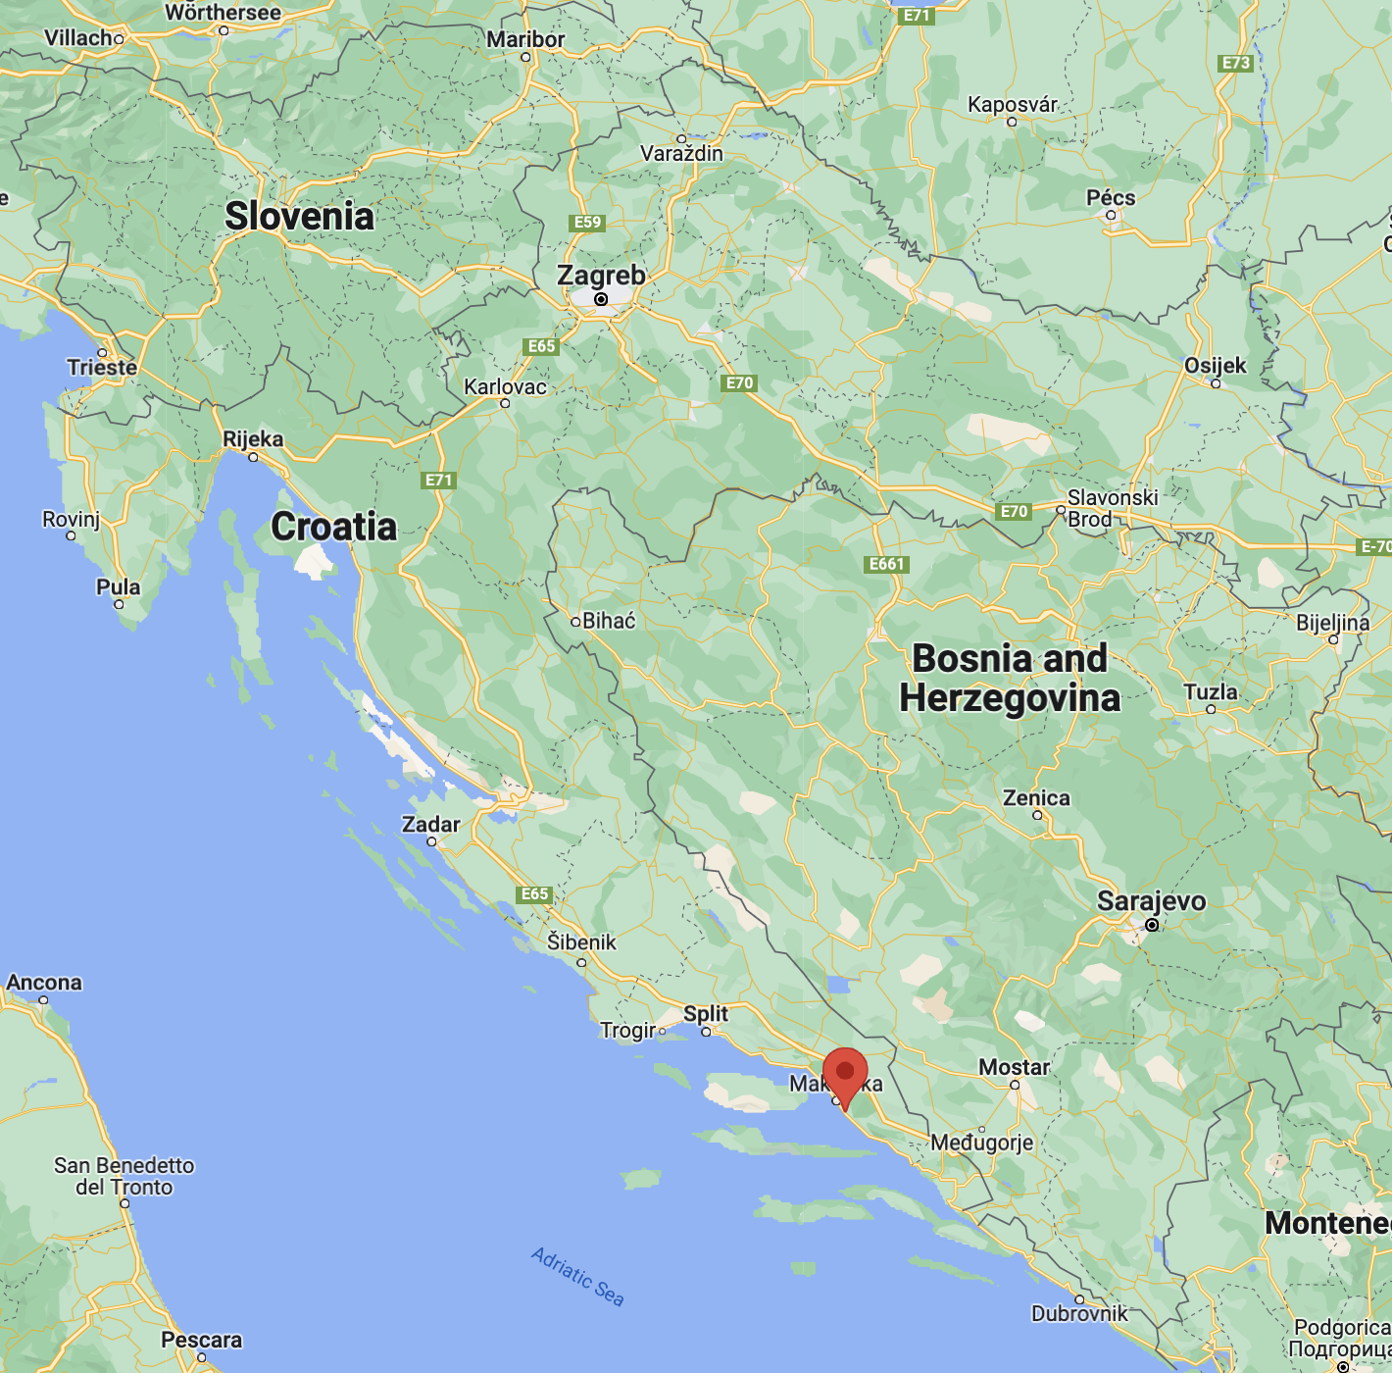
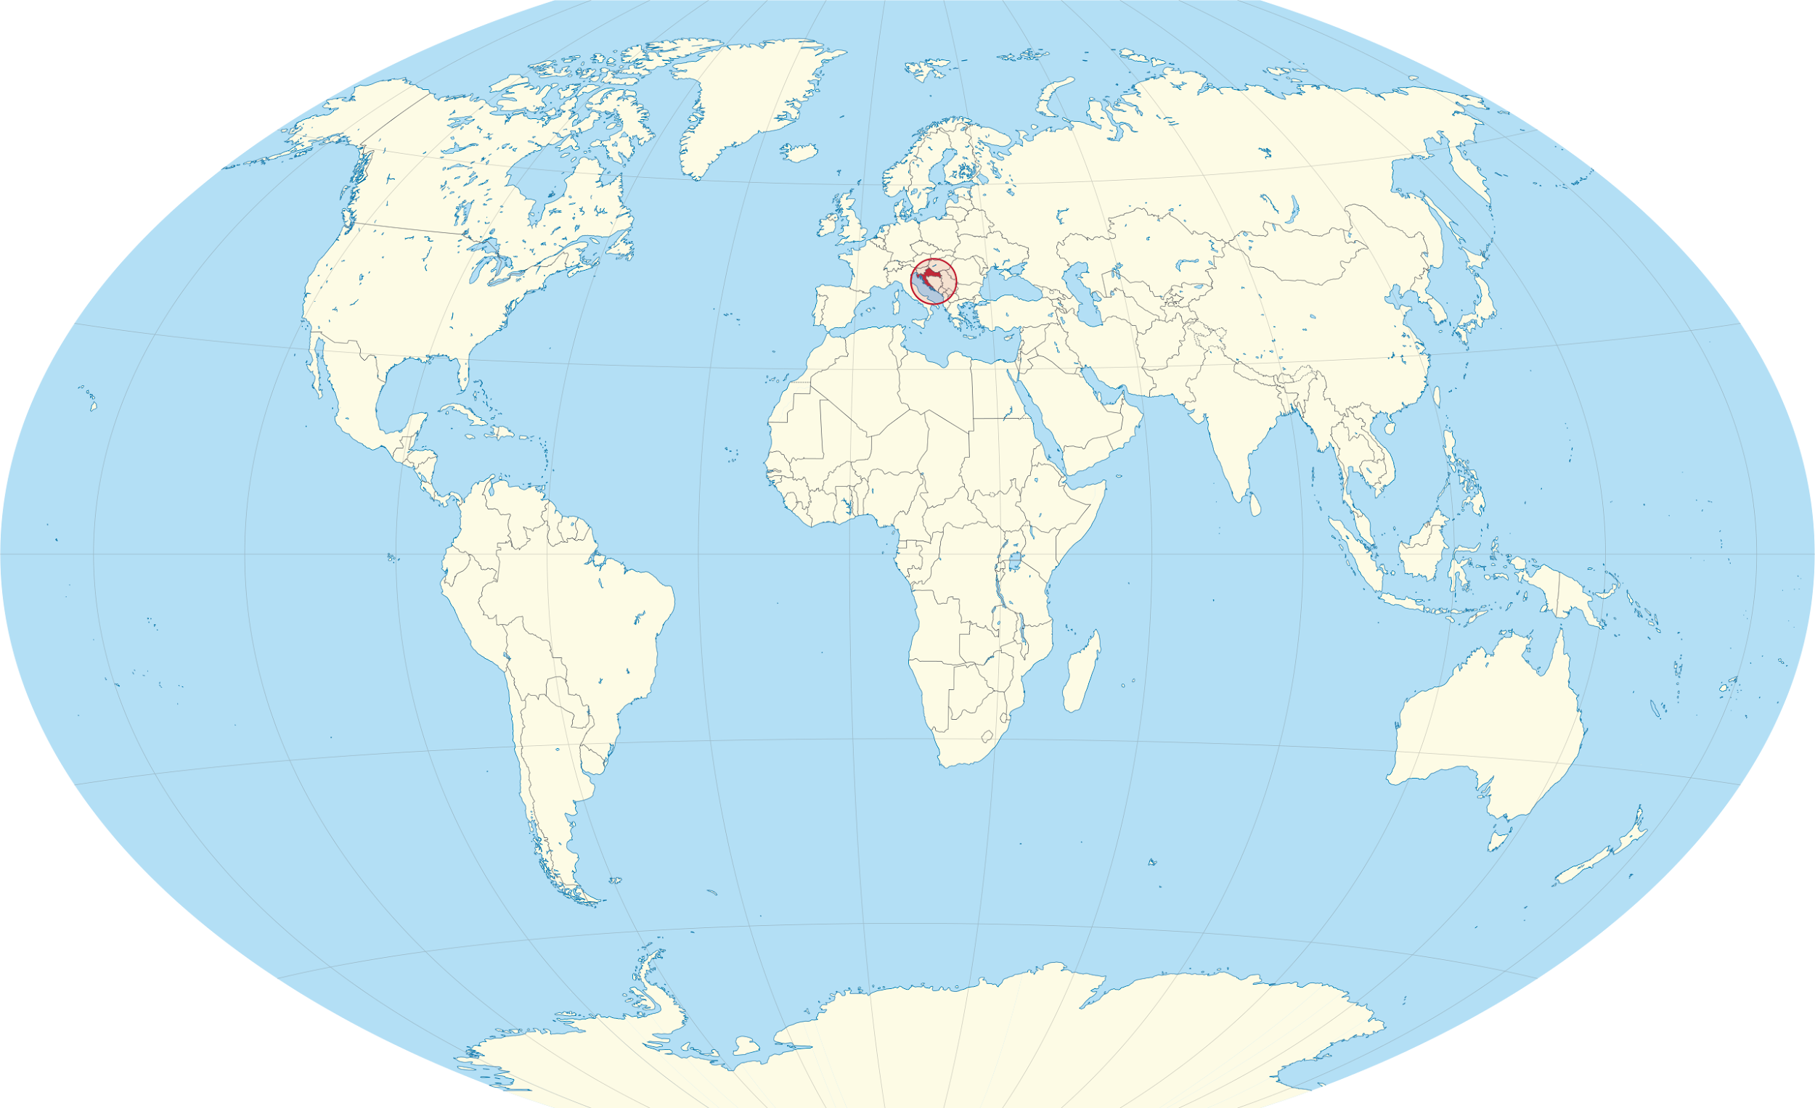

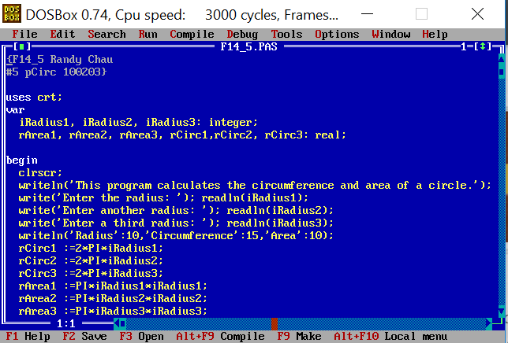




About your instructor this year
~1500 people
~ 3.850.000 people
Born in Tučepi, Croatia
Education:
University of Zagreb, Croatia
University of Tokyo
Stanford University, USA
Assistant Professor at EPFL since Sep ‘22
Machine Learning for Biomedicine (MLBio) lab

Slide 5


Our research @ MLBio
Methods
My Research
Biomedicine
MLBio
Lab
Machine
Learning
Challenges

Slide 6





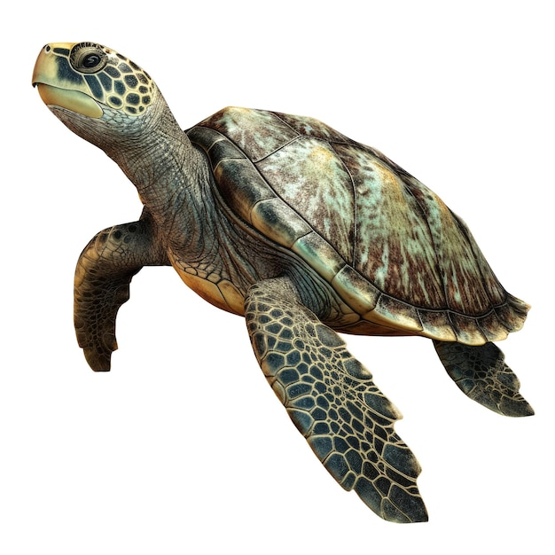
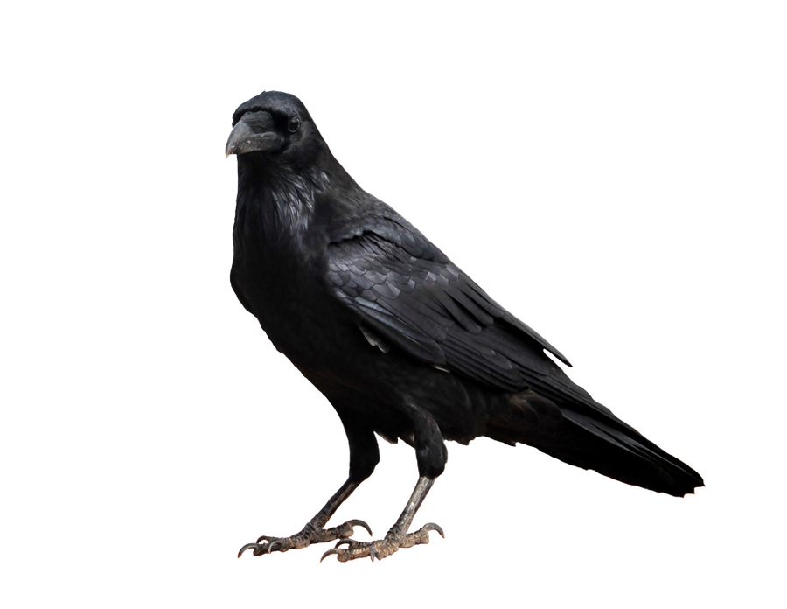
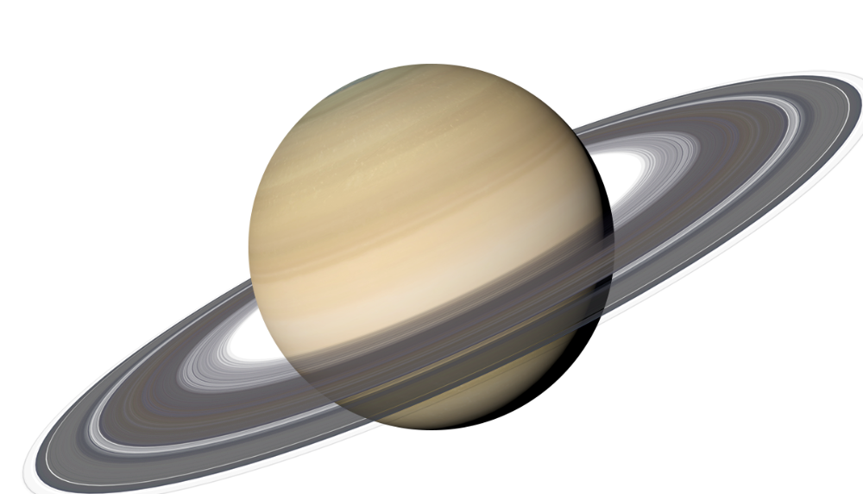
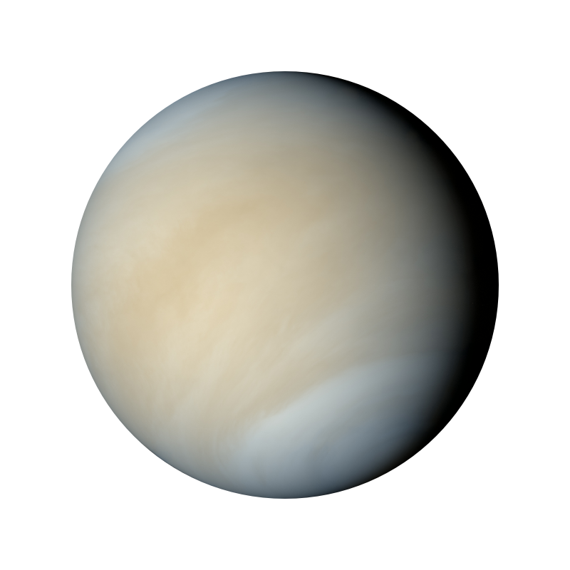
Our research @ MLBio
Develop new AI methods
Unsupervised learning, generative models, open-world learning etc
Collaborate with biologists and medical researchers and have new “untouched datasets” or collect datasets
Gain new insights from these datasets 🡪 what are interesting questions that need new AI algorithms to be answered?
Apply AI algorithms we develop to advance biomedical research and drive new discoveries in biology and medicine

Slide 7
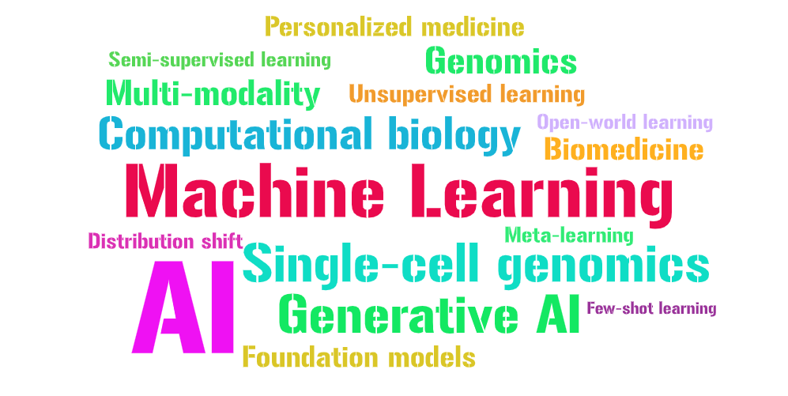
Our research @ MLBio

Slide 8

Data analysis
“... the process of inspecting, cleaning, transforming, and modeling data with the goal of discovering useful information, suggesting conclusions, and supporting decision-making.”
“Data analysis has multiple facets and approaches, encompassing diverse techniques under a variety of names, in different business, science, and social science domains.”

Slide 9
Applied data analysis
This course is about breadth, not depth
“What methods, principles, and tools are out there?”, rather than “How can I become an expert in deep learning for computer vision applied to images of cats?”
Data science is a fast-paced, shifting field
Obsessing on one tool or technique won’t pay off in a few years
Be ready to explore and keep learning on your own
Complementary courses:
Machine learning
NLP
DIS
Data viz
Goal of this class: Enable you to conduct a
full-fledged data science project from start to finish
That being said, depth matters too…

Slide 10
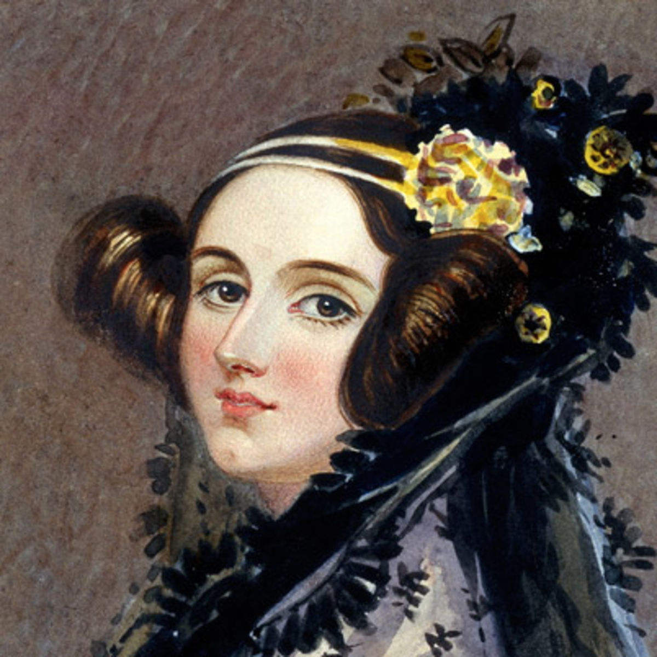
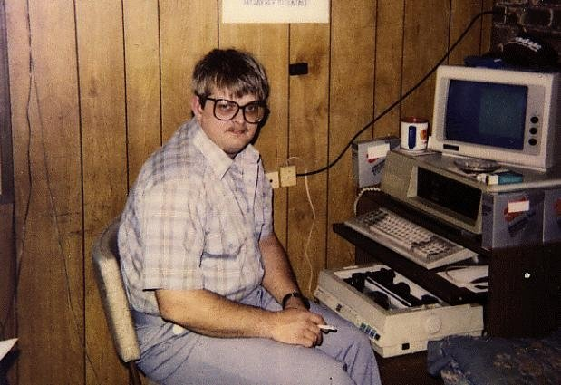
Let’s abbreviate this course as Ada, not A-D-A, in honor of Ada Lovelace, “the world’s first computer programmer.”
https://en.wikipedia.org/wiki/Ada_Lovelace

Slide 11
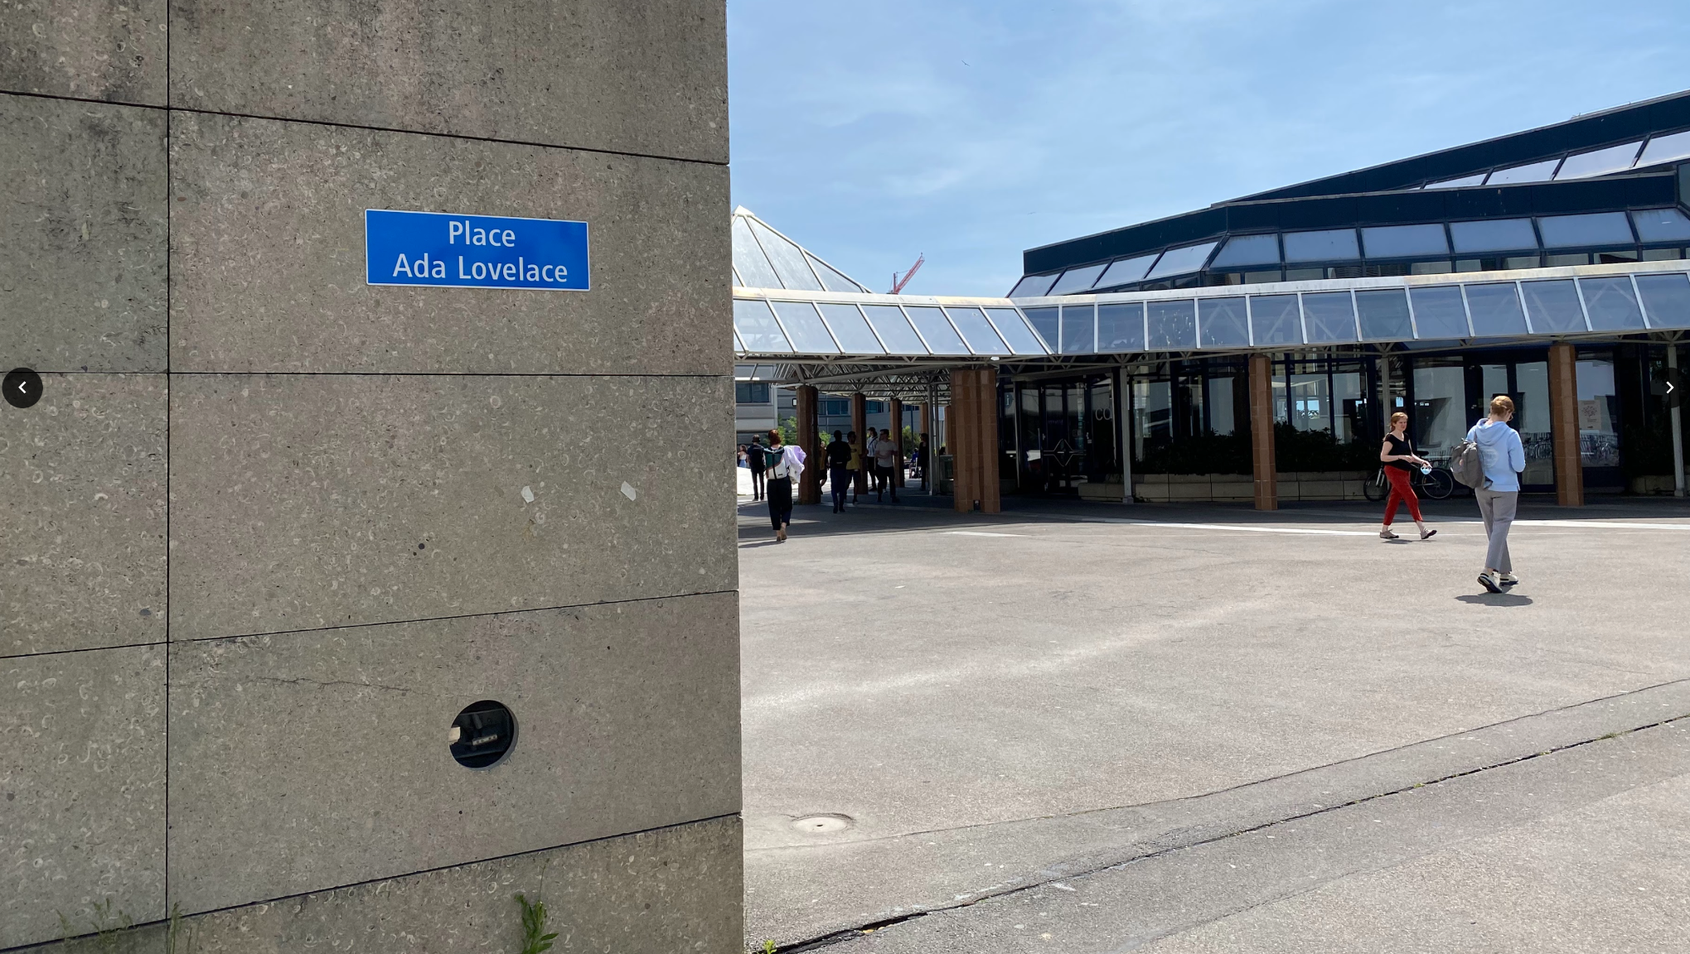

Slide 12
Syllabus
Handling data
“Slicing and dicing”: obtaining, preparing, juggling data
Visualizing data
Exploration of data, communication of results
Describing data
How to support (and be suspicious of) claims about data
Regression analysis for disentangling data
How to disentangle datasets with correlated variables
Causal analysis of observational data
How to deal with “found data”
Correlation != causation

Slide 13
Syllabus (cont’d)
Learning from data
Supervised learning
Unsupervised learning
Applied aspects of machine learning
Handling specific types of data
Handling text data
Handling network data
Scaling to massive data

Slide 14

Grading
35% Homework assignments (2)
Involving skills required from data scientists
Groups of 5 students
Homework of 2017, 2018, 2019, 2020, 2021, 2022, 2023
35% Final exam
Mini data analysis project
Done on laptop, individually, on campus
Final exams of 2017, 2018, 2019, 2020, 2021, 2022, 2023
30% Project (more details soon)
Your own freestyle data analysis
Done in groups of 5 students (same as for homework)
Milestones spread throughout the semester
Projects of 2017, 2018, 2019, 2020, 2021, 2022, 2023

Slide 15
Grading
35% Homework assignments (2)
Involving skills required from data scientists
Groups of 5 students
Homework of 2017, 2018, 2019, 2020, 2021, 2022, 2023
35% Final exam (date TBD)
Mini data analysis project
Done on laptop, individually, on campus
Final exams of 2017, 2018, 2019, 2020, 2021, 2022, 2023
30% Project (more details soon)
Your own freestyle data analysis
Done in groups of 5 students (same as for homework)
Milestones spread throughout the semester
Projects of 2017, 2018, 2019, 2020, 2021, 2022, 2023
This class will be hard work,
but it will get you a job.

Slide 16
Grading (cont’d)
To obtain a meaningful grade distribution, scaling/shifting will be applied to each of {homework, project, exam, quizzes} before taking weighted average (standard practice at EPFL)
While intermediate grades are a good indication of where you stand, remember there might be some wiggle
→ Don’t rely on intermediate grades to decide whether you can afford to skip the exam etc.

Slide 17

Deadlines
Homeworks
Homework 1
Release Oct 4th 2024
Due Oct 18th 2024
Homework 2
Release Nov 15th 2024
Due Nov 29th 2024
Final exam
Date TBD
Project deliverables
Project milestone P1
Due Oct 4th 2024
Project milestone P2
Due Nov 15th 2024
Project milestone P3
Due Dec 20th 2024
All deadlines are 23:59 CET

Slide 18
Meeting logistics: Lectures
Wednesdays 8:15–10:00
If you want to see it live, come to class! (No live streaming)
Lectures are also recorded and made available after class

Slide 19
Meeting logistics: Lab sessions
Fridays 13:15–14:45
In person only:
CO 1
CM 1 120
CM 1 121
Labs are complementary to lectures, not simply more detail on same
You solve exercises that we make available the day before, can ask questions and get help from assistants
In certain weeks: homework/project office hours (probably on Zoom, in parallel to exercises)

Slide 20
Weekly quizzes
Available online on Moodle after every lecture
5 questions, to be answered within 10 minutes of starting
Quiz 1: no real questions, just to let you get familiar with the setup
Quiz 2: the first quiz with lecture material questions
Quiz i is about lecture material of week i
Goal:
Engage continuously with course material
Think (not just find right slide)
Not graded, for you to recap lecture materials

Slide 21
Project
We’ll provide a number of datasets
You need to form and pitch a crisp project idea
Free to combine with other datasets (at your own risk)
Goal: not a loose collection of results – tell a story with the data!
Data stories of 2017, 2018, 2019, 2020, 2021, 2022, 2023
Nice example data story

Slide 22

Homework and projects: GitHub
De-facto standard for managing and sharing code
All students in this class need a GitHub account
Homework and project submissions done via GitHub
ADA Github repository:
https://github.com/epfl-ada/2024

Slide 23
Main communication channel:
Class forum, available via Moodle
Also accessible directly, outside of Moodle: https://go.epfl.ch/ada2024-ed (sign in using the same email address as for Moodle)
Central place to ask all class-related questions
Don’t send us email
Mandatory! We’ll send important announcements on Ed only
Help each other (without cheating, of course)

Slide 24
Watch-at-home videos
Throughout the semester, we’ll release videos with supplemental information; e.g.,
Intro to lab sessions (already available!)
Project instructions
Homework 1 postmortem
Homework 2 postmortem

Slide 25
General note on communication
Multiple platforms used in ADA for various tasks (as in real life): Ed, GitHub, Google docs, ADA website
To avoid confusion,
familiarize yourself with communication guidelines
all materials will be linked from the website as a central point of entry: https://ada.epfl.ch
all discussions will take place on Ed

Slide 26
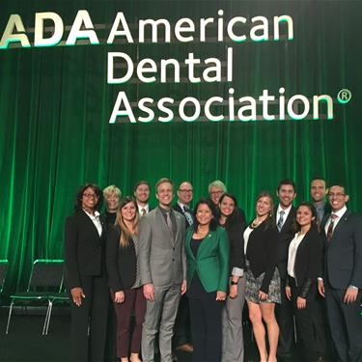
Commercial break
ADA students: sharp like teeth!

Slide 27
Group registration
Must form teams within 2 weeks, starting now (in time for release of Homework 1)!
Get started immediately to find 4 other teammates
By Fri 27 Sep 23:59, complete the registration form (to be done by each team member individually): https://go.epfl.ch/ada2024-team-registration
Can change team after Homework 1 (but try to avoid it)

Slide 28

Prerequisites
Basics of
probabilities and stats
databases
programming
You won’t survive if you can’t program
Homework, exam: Python required
Project: up to you, but we support only Python
Brush up your Python skills (many great online courses out there)

Slide 29
Python environments
Homeworks and exams to be done as Jupyter Notebooks
You will submit a pre-executed .ipynb file
We don’t care how you produce it
Option 1: local Python installation (e.g., Anaconda + JupyterLab)
Option 2: Google Colab = notebook hosted by Google
Option 3: noto = notebook hosted by EPFL
To get started: come to Friday’s lab session (“Exercise 0”)
“Homework 0”: do it yourself at home after lab session (optional, not graded)
Doing Homework 0 is the best way of making sure you’re set up correctly for later homework, project, exam

Slide 30





Python++

Slide 31


POLLING TIME
“What is your prior experience with Python?”
Scan QR code or go to https://app.sli.do/event/iPMVwwrojFn9EaNp6iiDDx

Slide 32
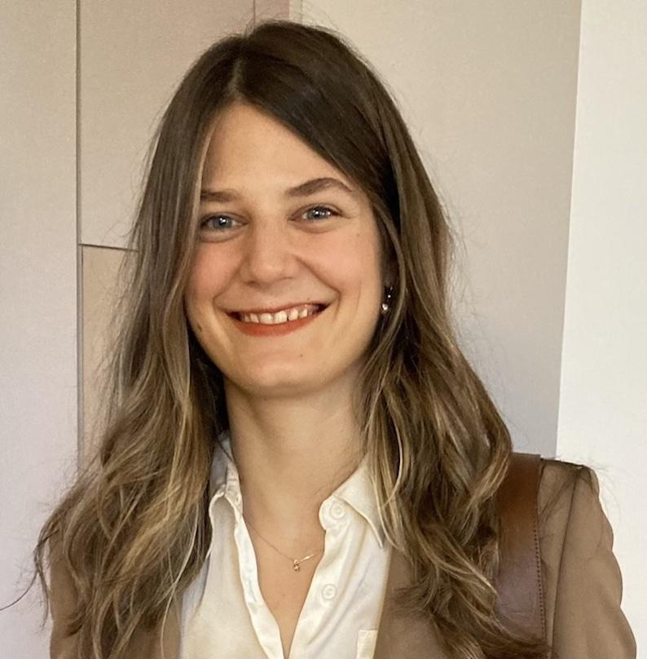



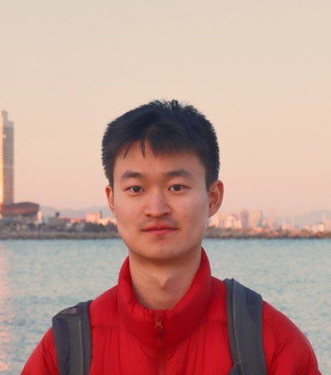

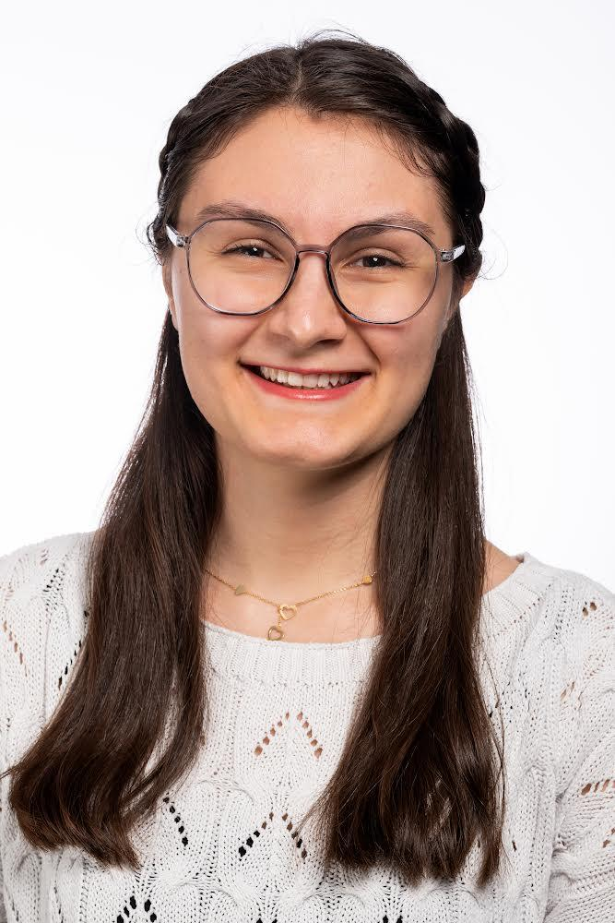
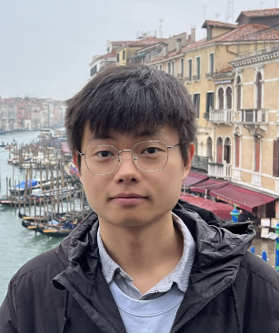
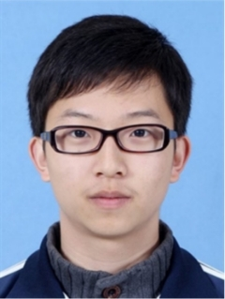




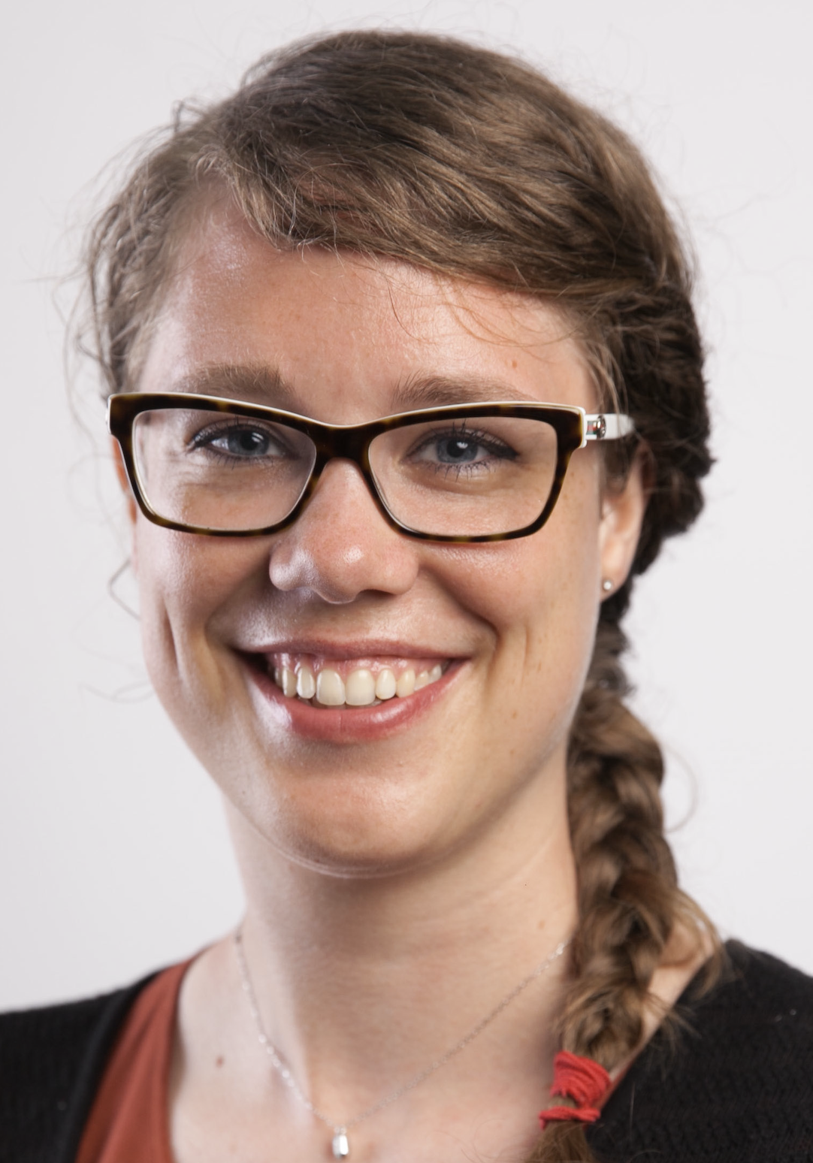

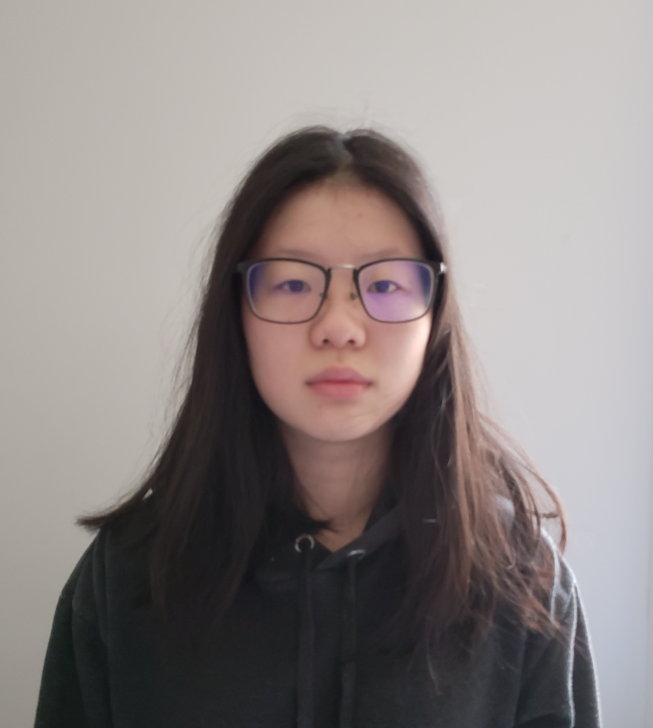

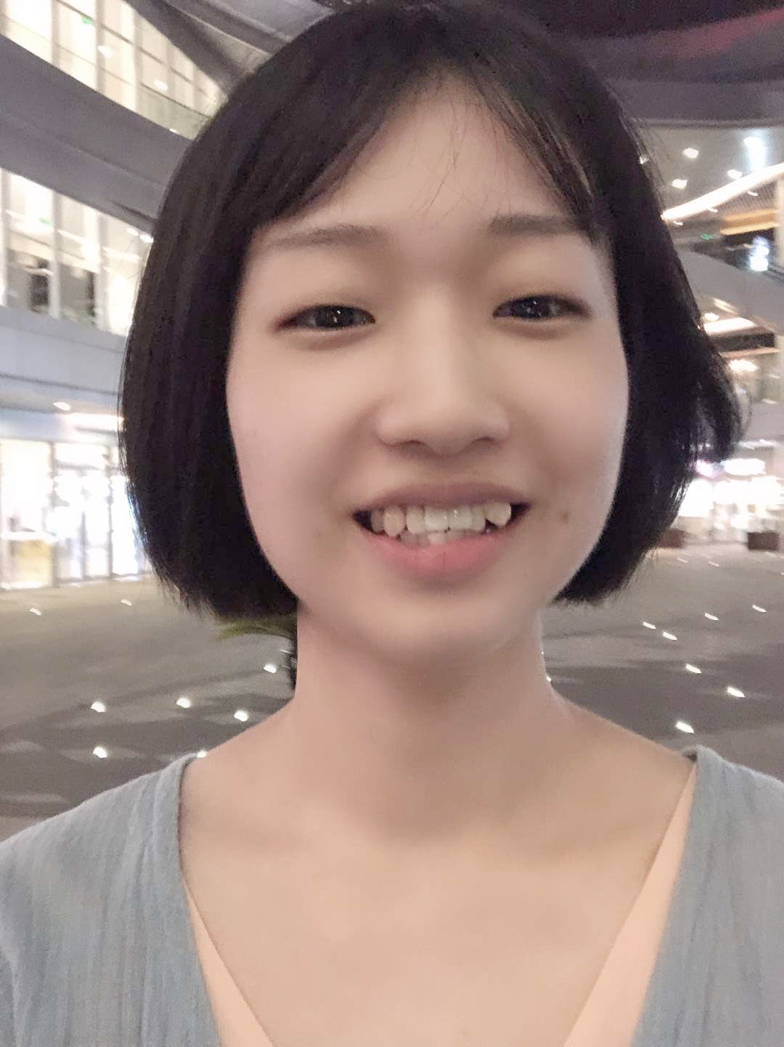
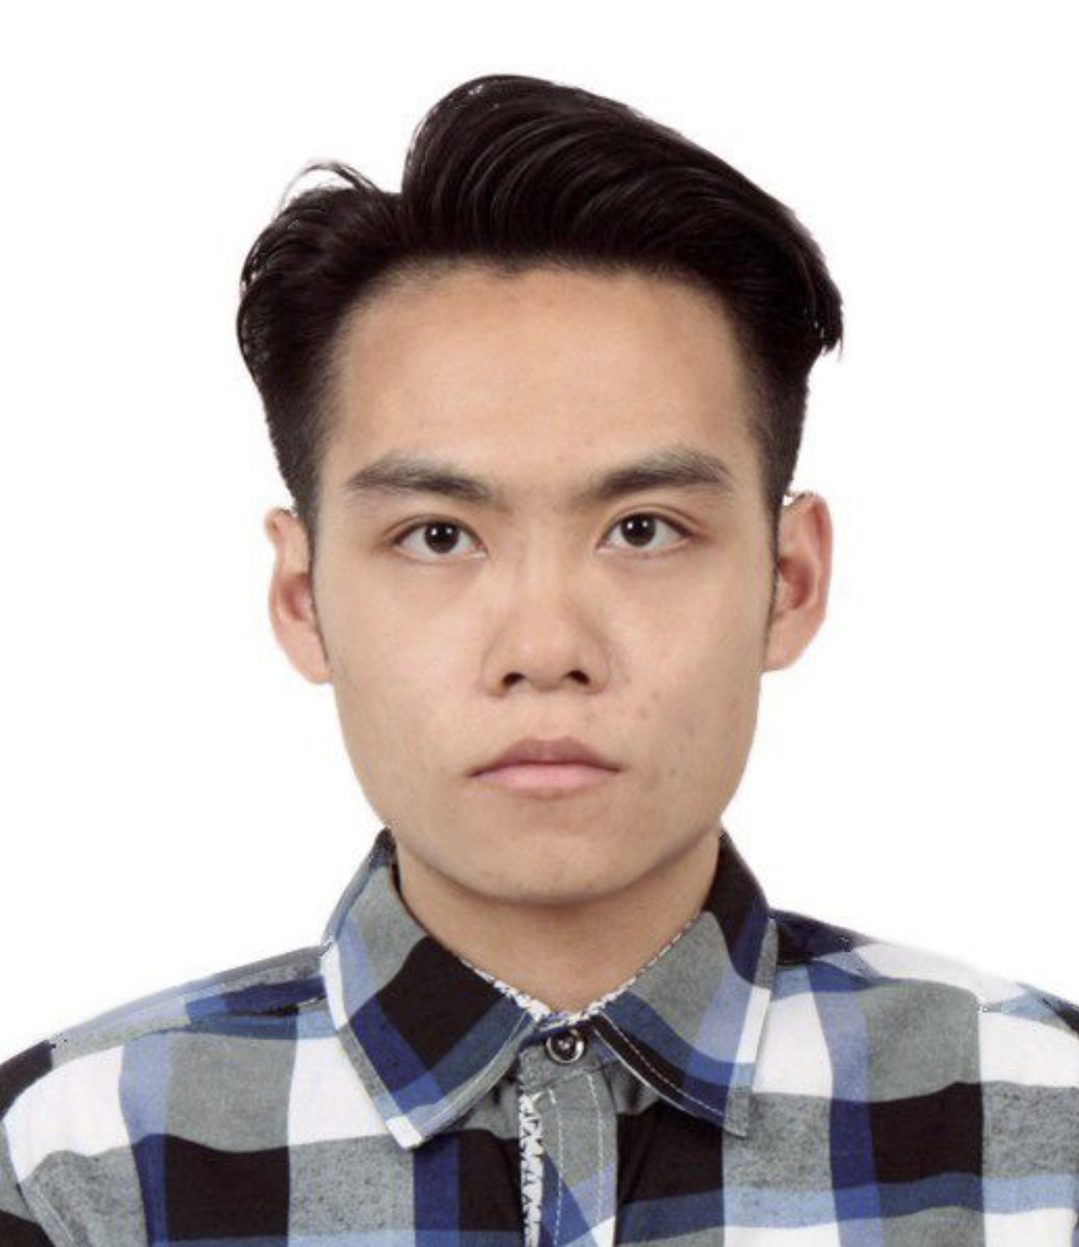


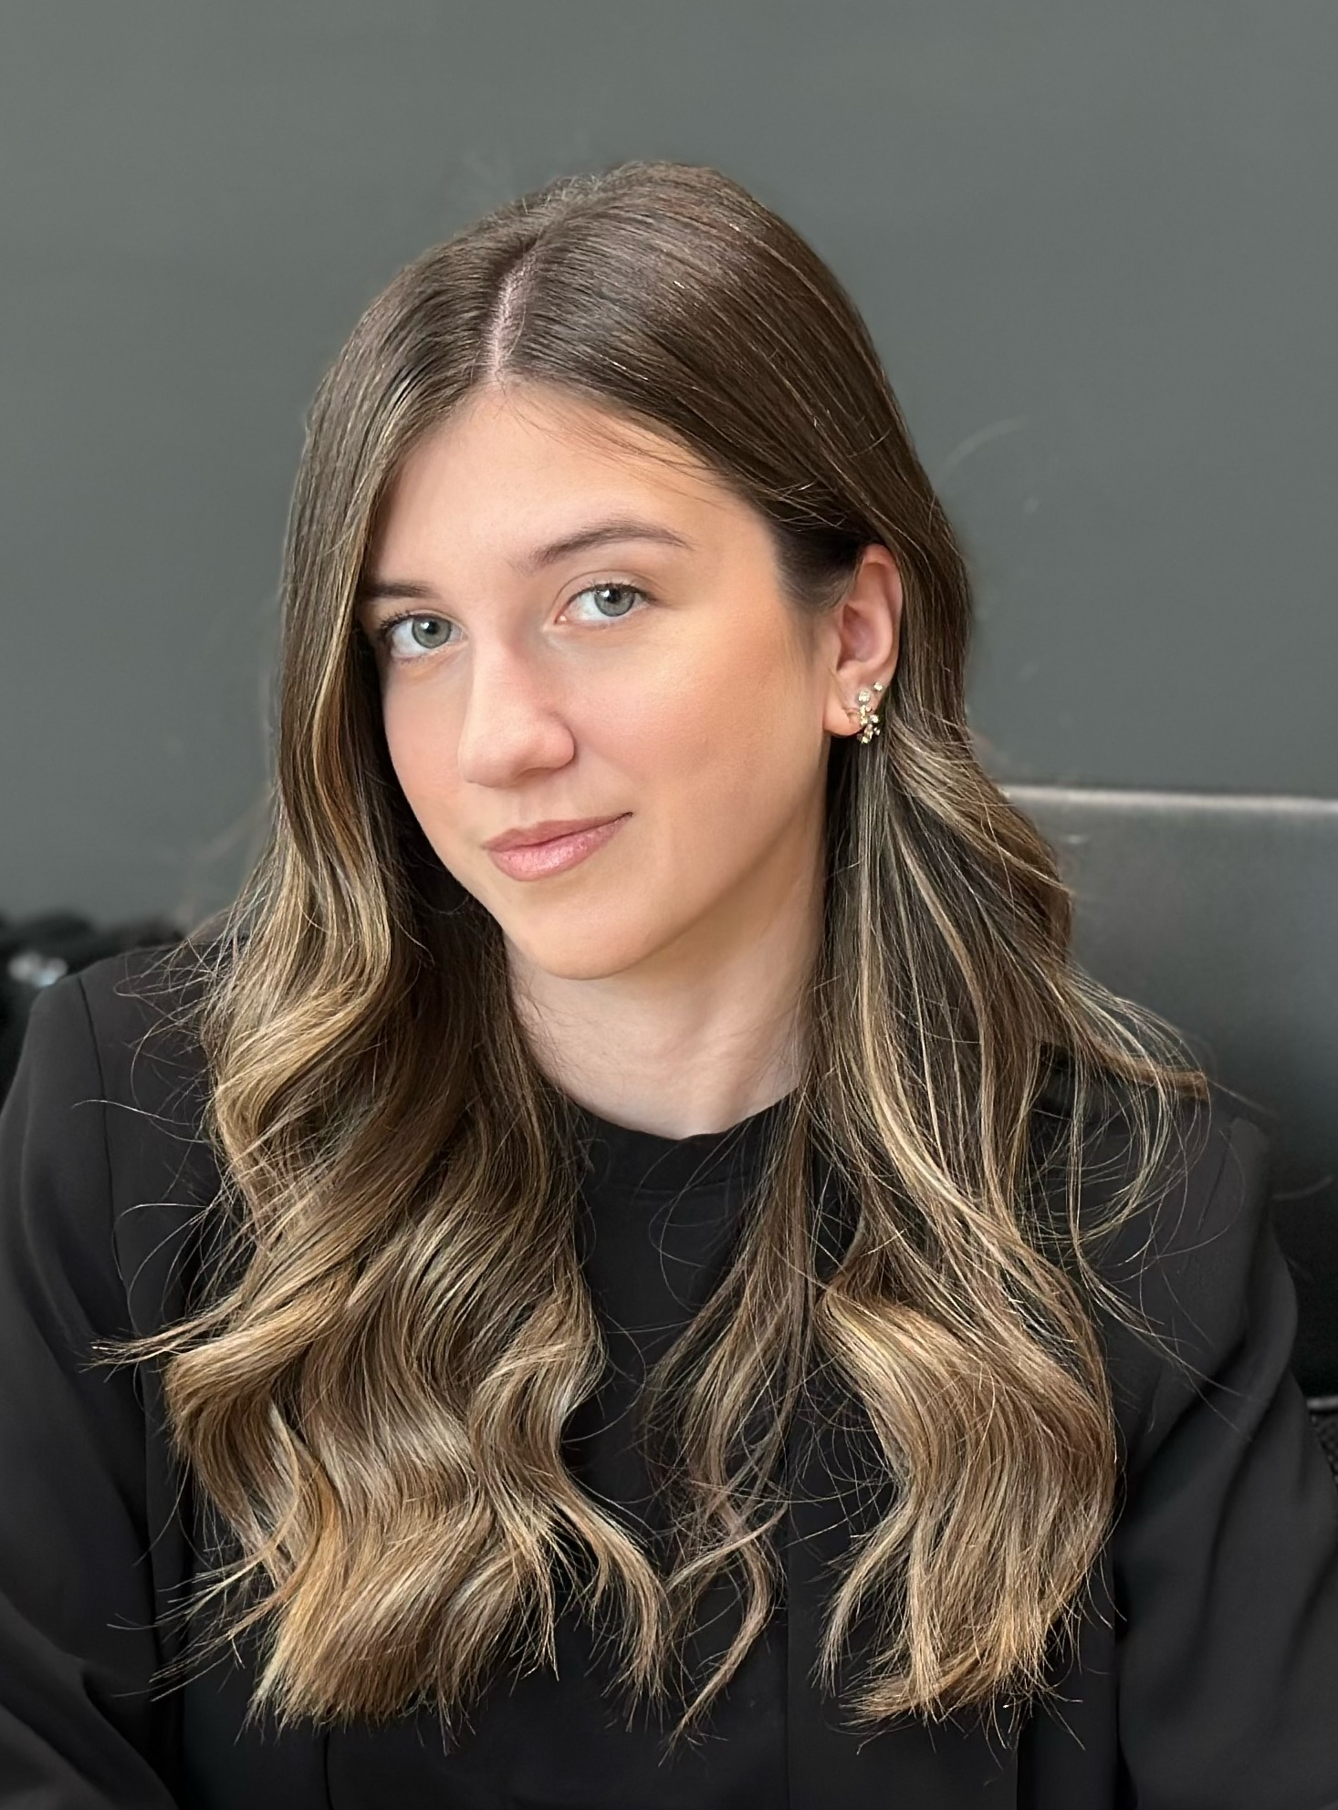
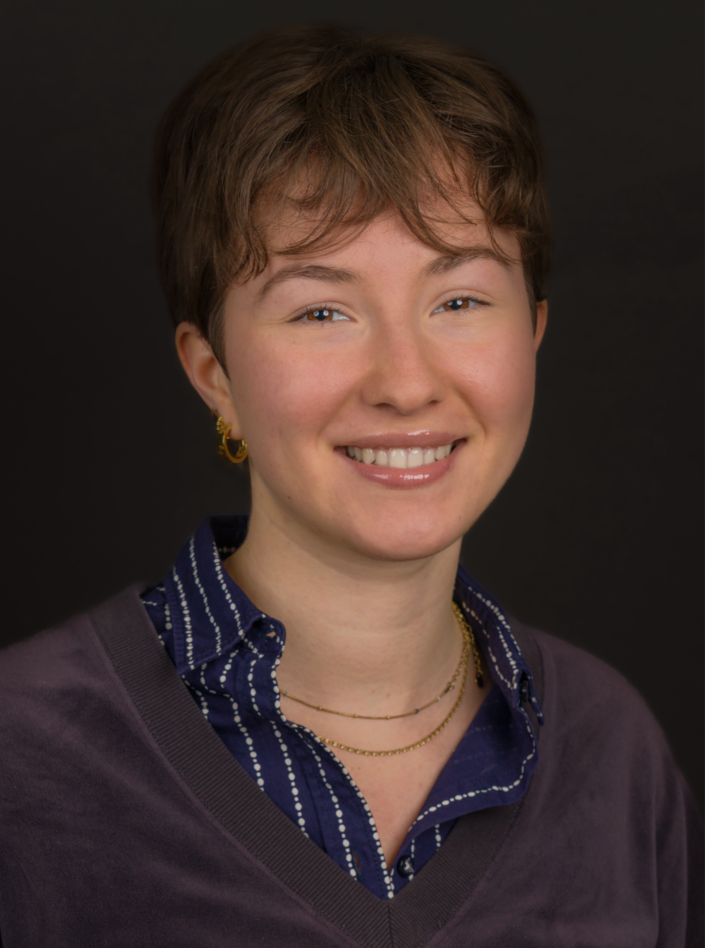

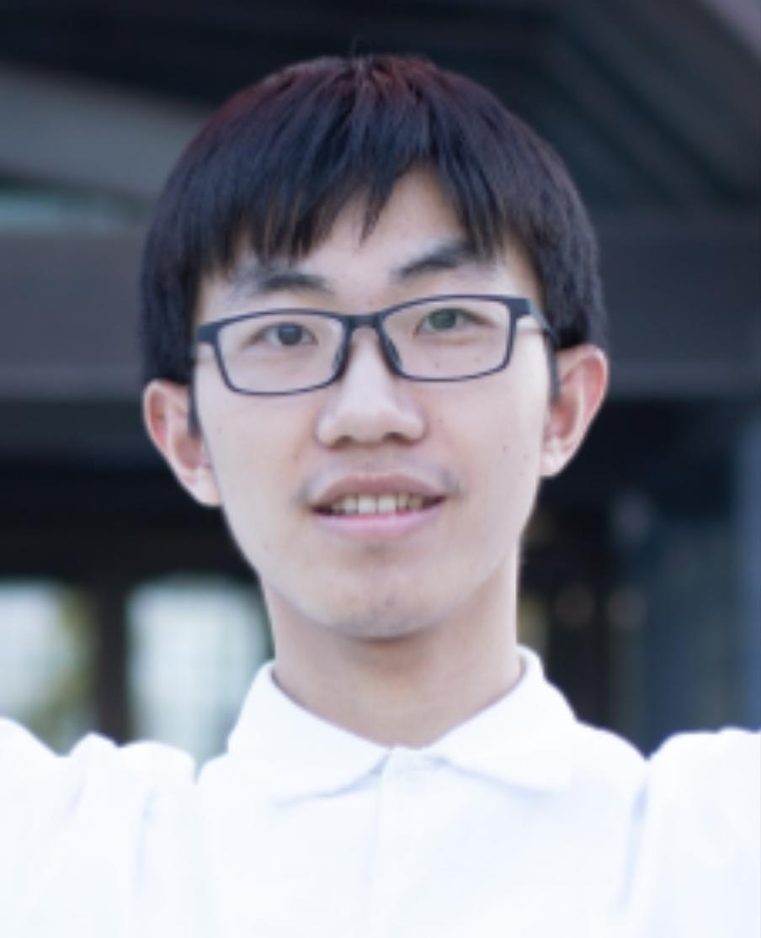

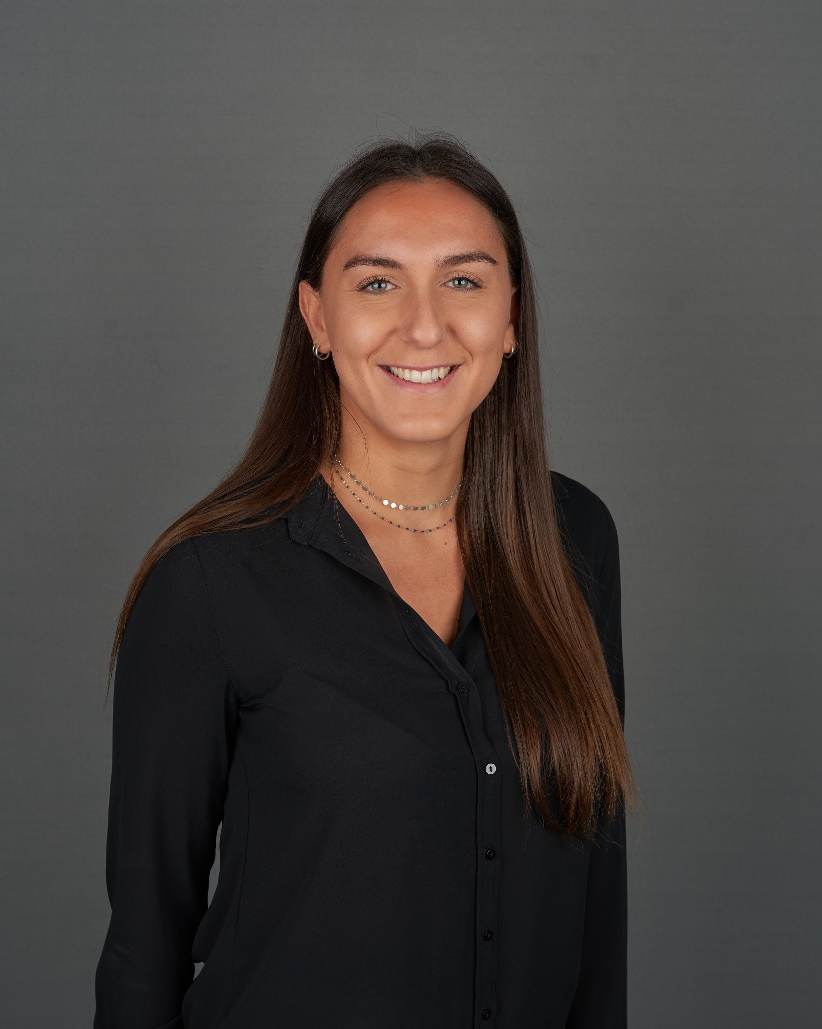

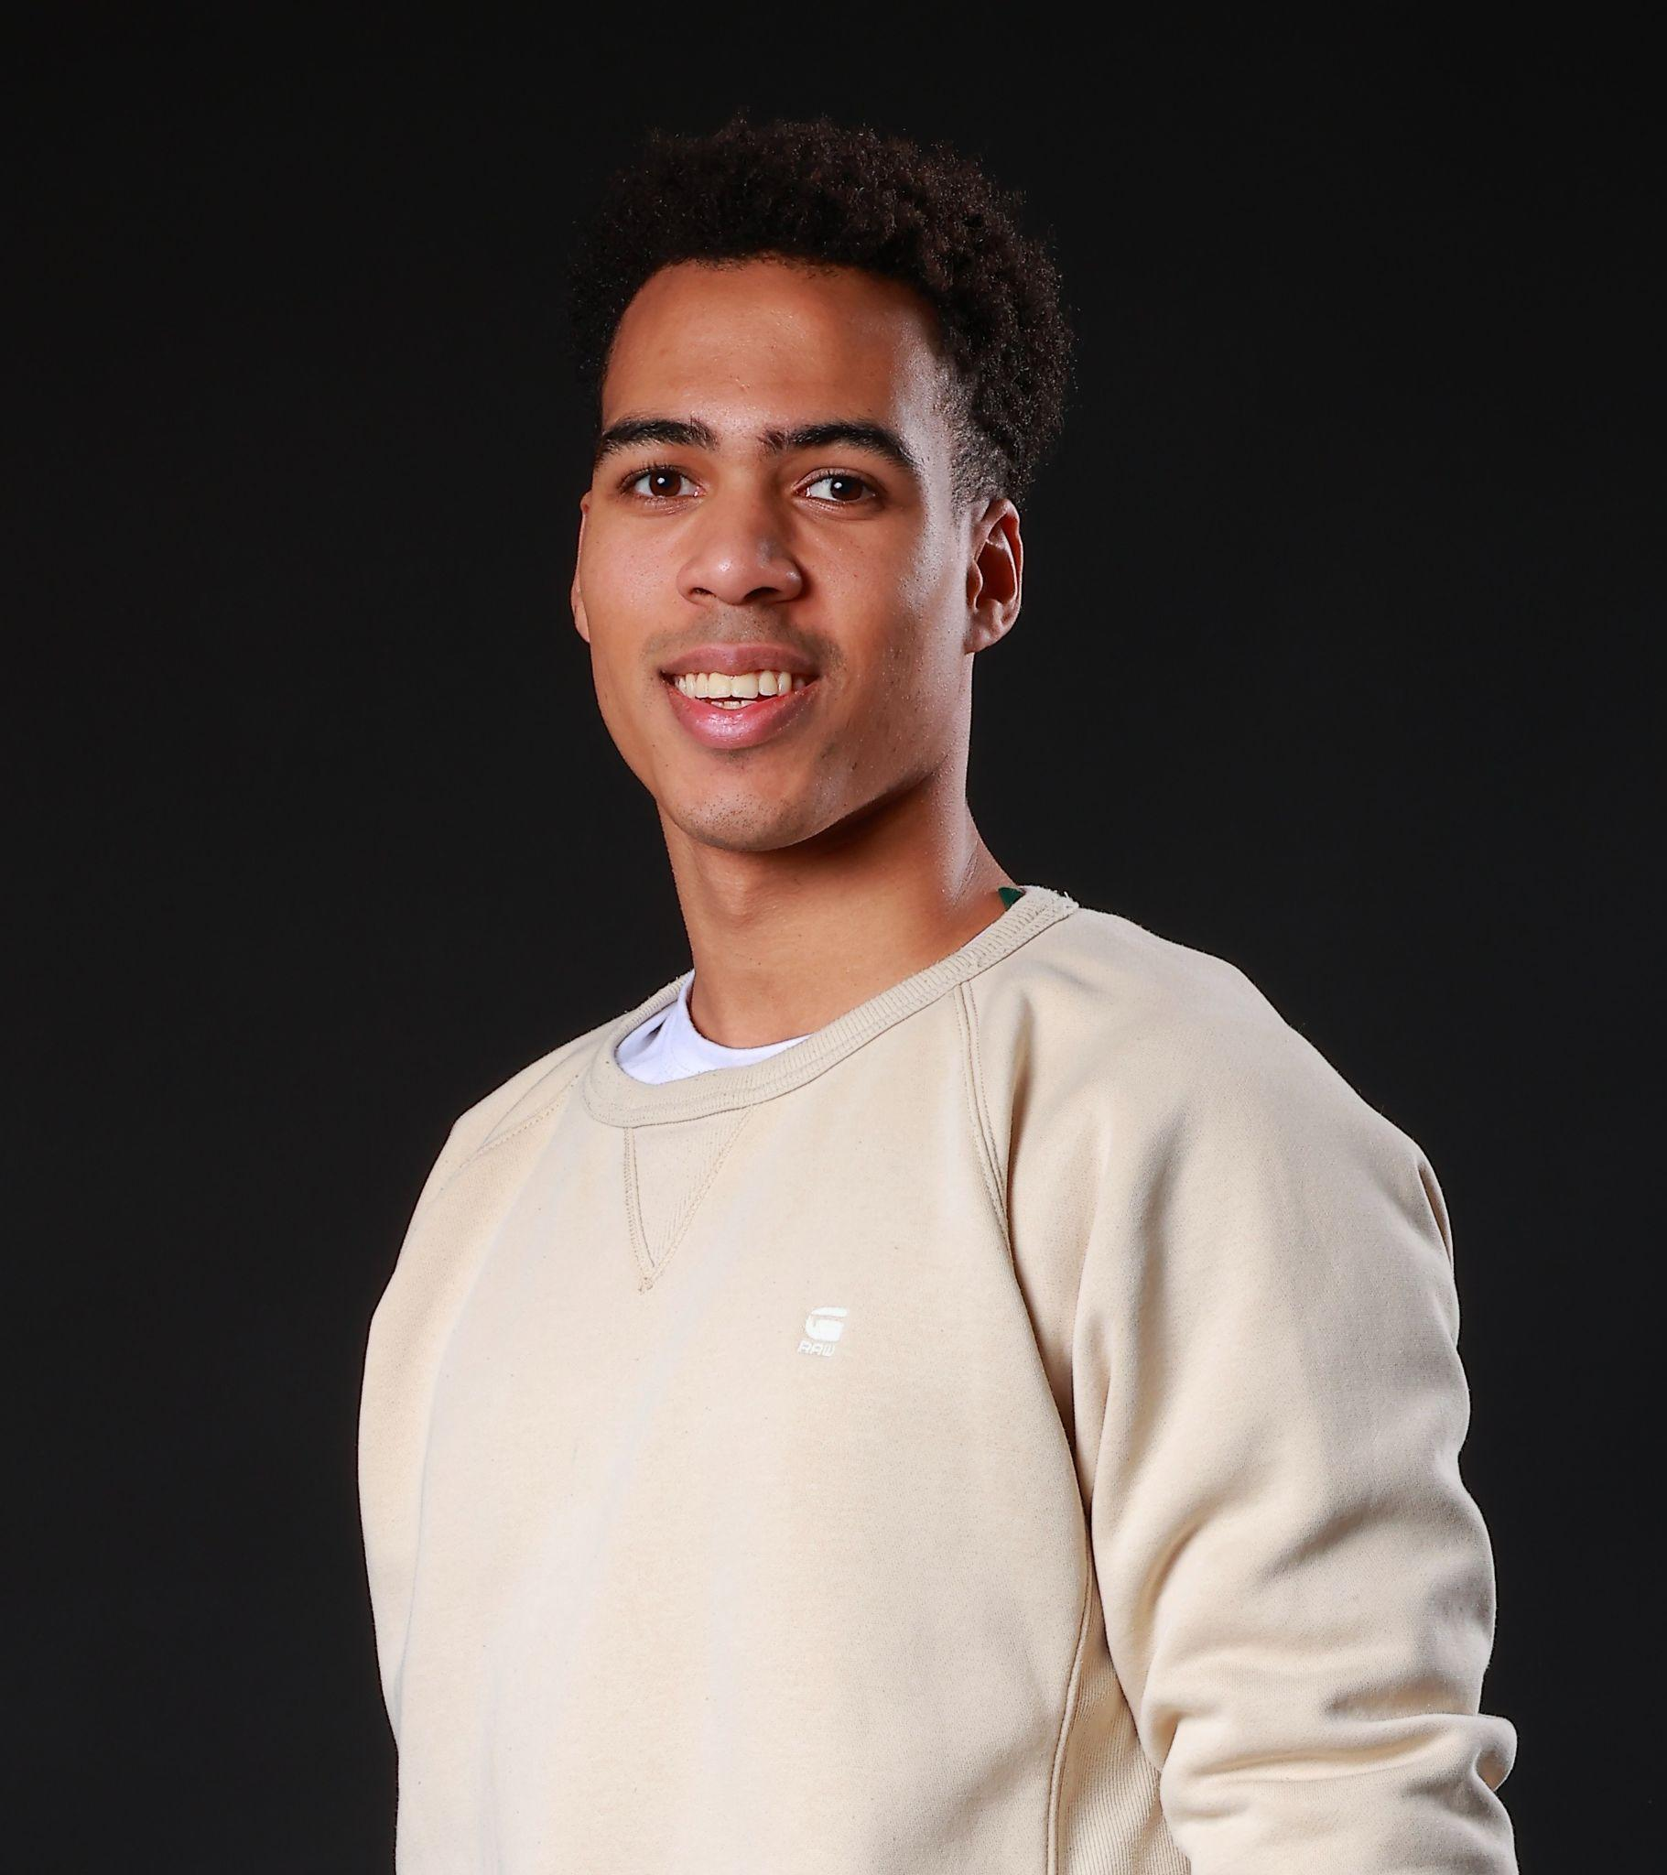
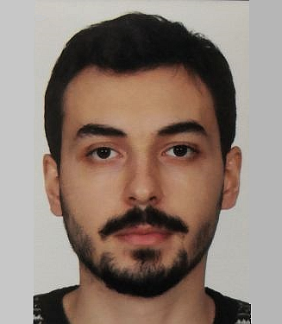

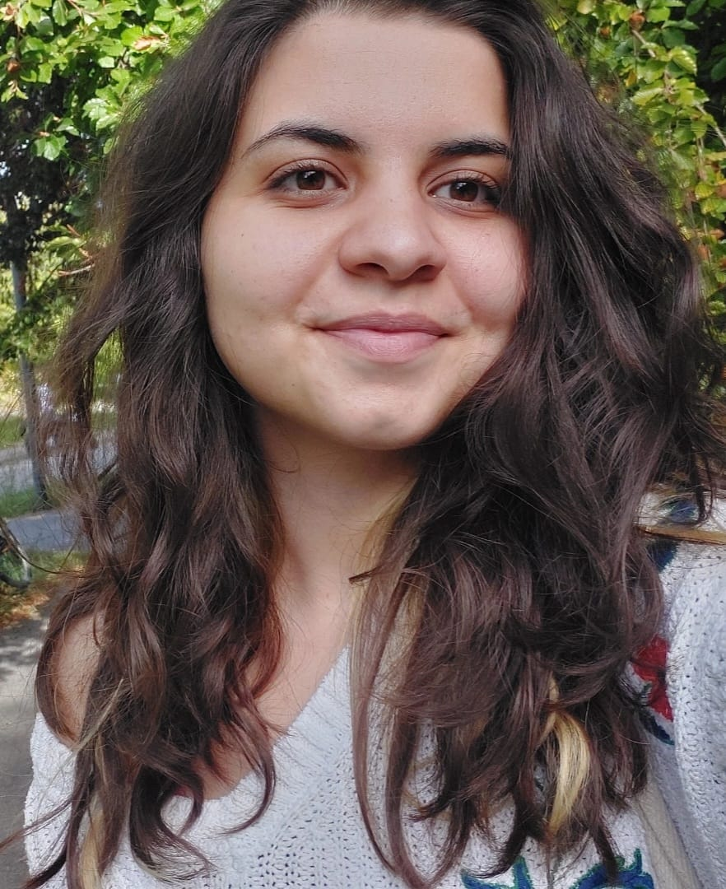
Instructor
Head TAs
TAs: Teaching assistants (PhD students)
Maria Brbić
Marija Šakota
Saibo Geng
Mohammad
Masani
Silin Gao
Tim Davidson
Sepideh
Mamooler
Aoxiang Fan
Shuo
Wen
Artyom Gadetsky
Yist
Yu
Shawn Fan
Yulun
Jiang
Bettina
Messmer
Ivan
Zakazov
Shuqi
Wang
Ziyi
Zhang
Shuangqi
Li
Yunzhen
Yao
SAs: Student assistants (Master students)
Stefan
Krsteski
Xi
Lei
Matea
Tashkovska
Elisa
Billard
Pablo
Menéndez
Jiaming Jiang
Yannis Laaroussi
Allocio
Jeanne
Jakhongir Saydaliev
Sebastien
Chahoud
Yagiz
Gençer
Tianhao
Dai
Tugba
Tümer

Slide 33

Help each other on Ed
Participate actively in classes and labs
Give us feedback

Slide 34
Feedback
Give us feedback on this lecture here: https://go.epfl.ch/ada2024-lec1-feedback
Feedback form available for each lecture and lab session
What did you (not) like about this lecture?
What was (not) well explained?
On what would you like more (fewer) details?
…

Slide 35

Questions?

Slide 36
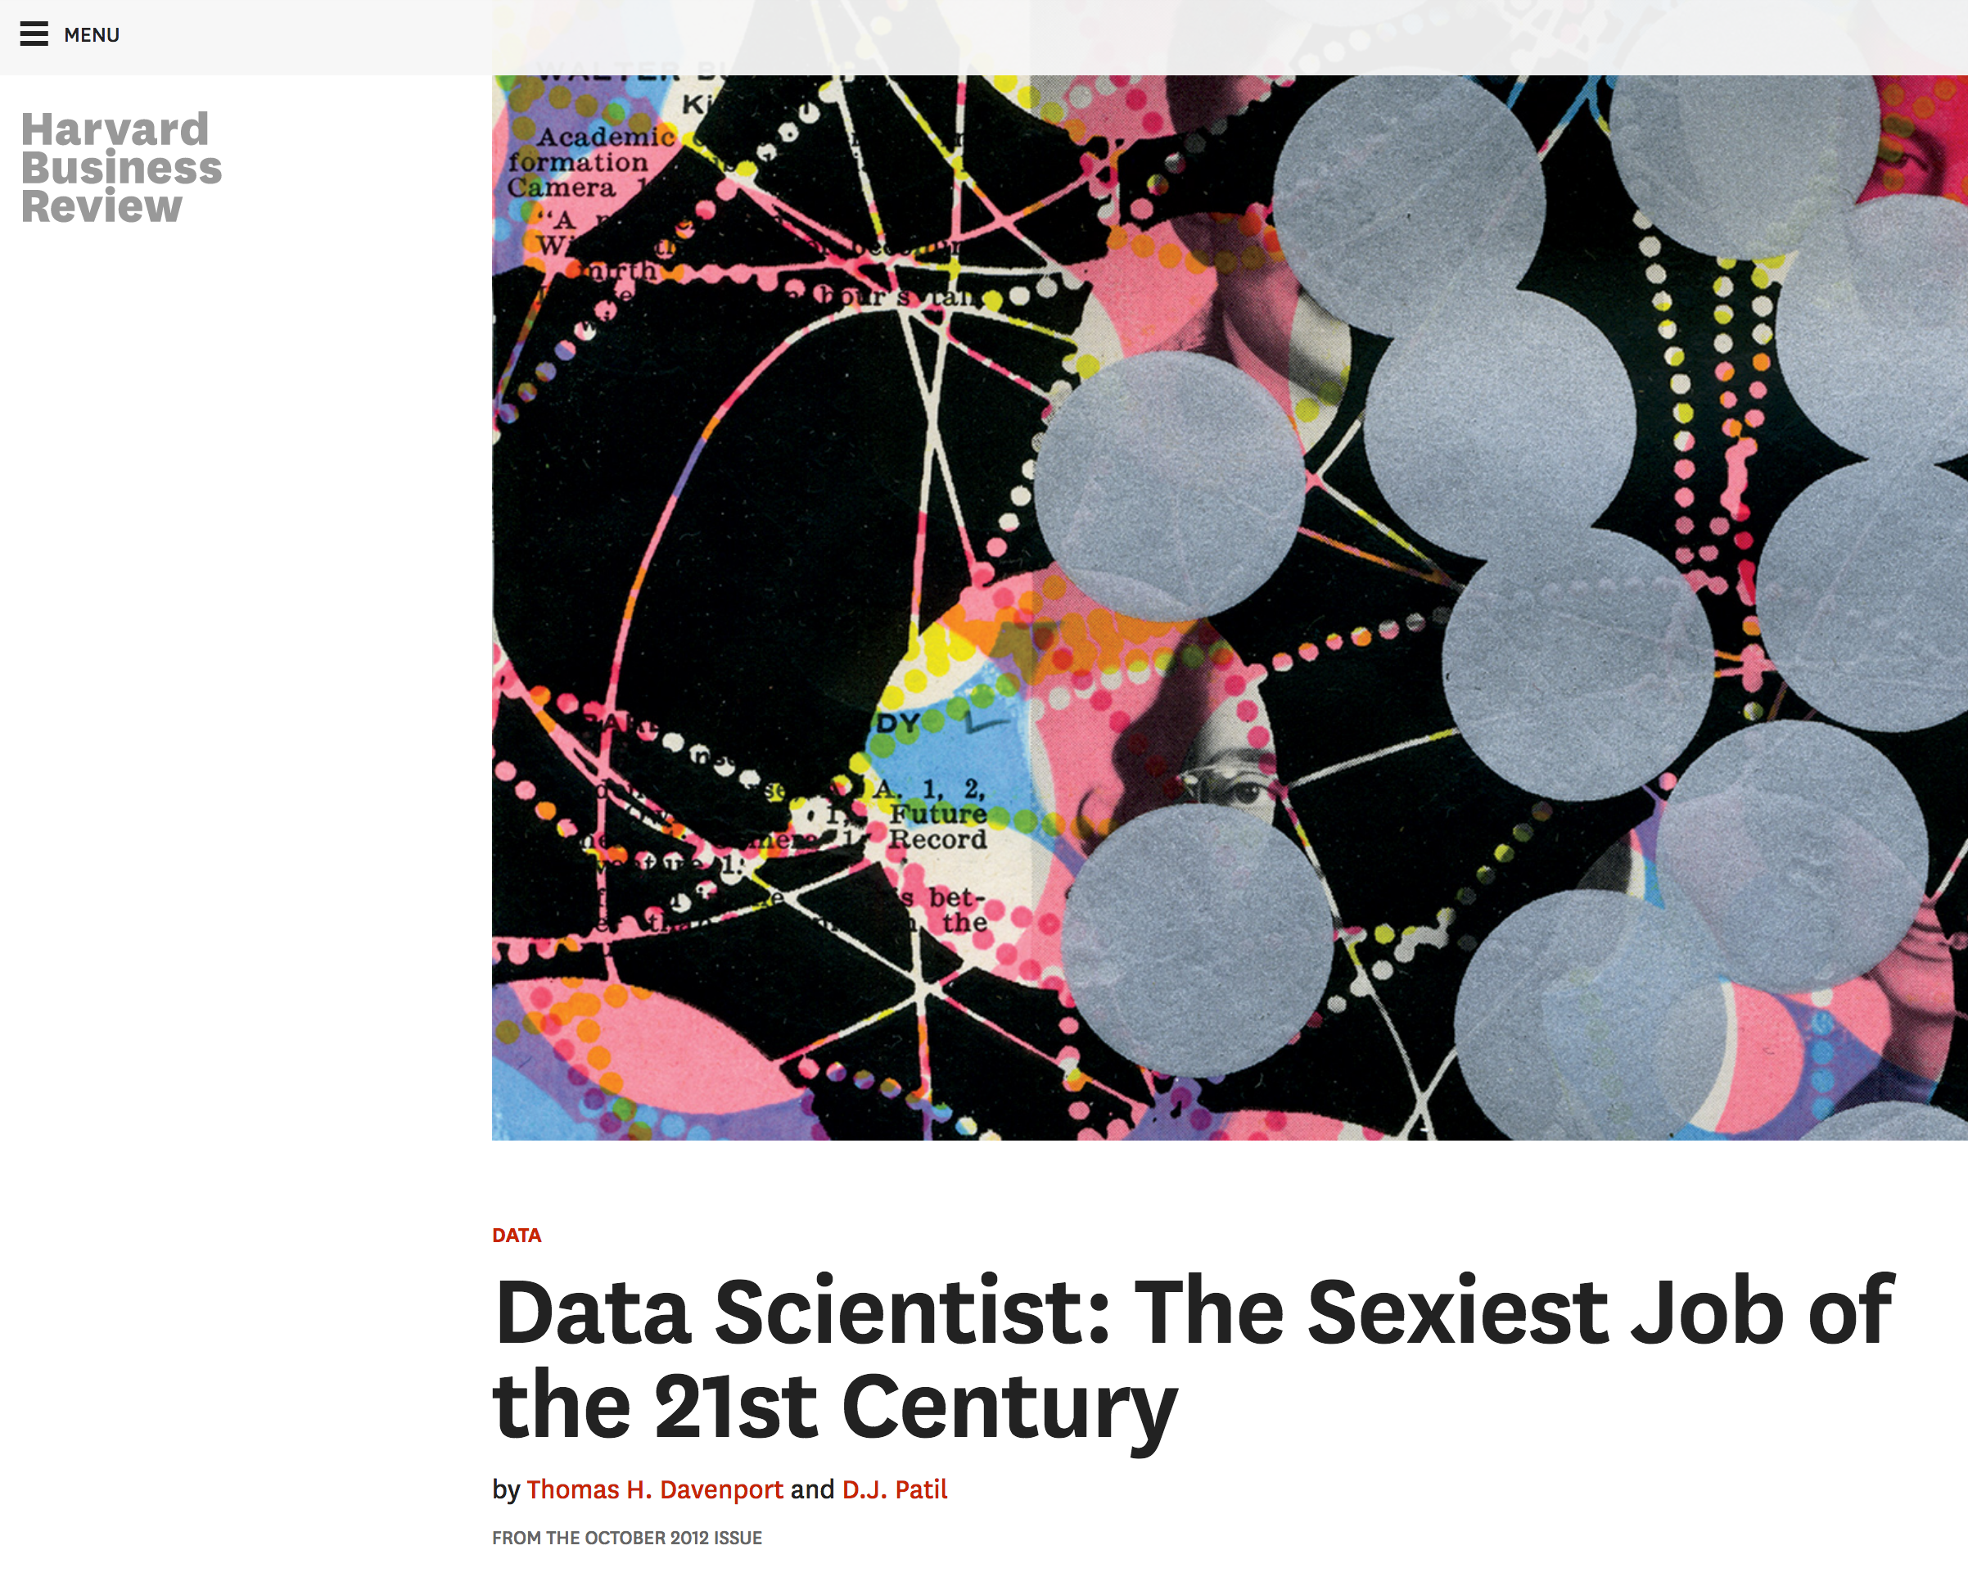
What is data science?

Slide 37
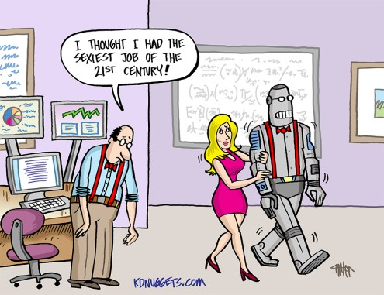
Why now?
I WISH I HAD BECOME A DATA SCIENTIST BACK IN 2023…

Slide 38
“Data science”
Most science is (or should be) based on data, per definitionem
So how is “data science” different from plain old “science”?

Slide 39
Data volume explodes
“Between the dawn of civilization and 2003, we only created five exabytes of information; now [in 2010] we’re creating that amount every two days.”
Eric Schmidt, Google (2010)

Slide 40
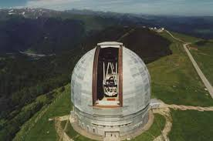
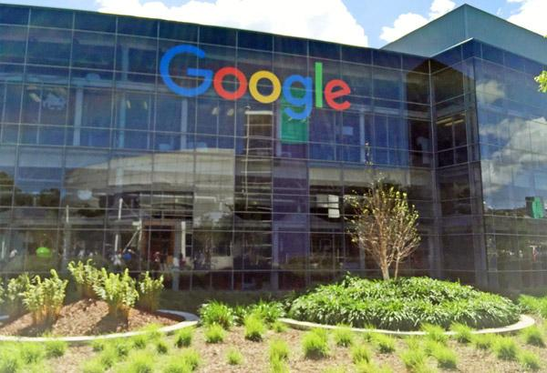
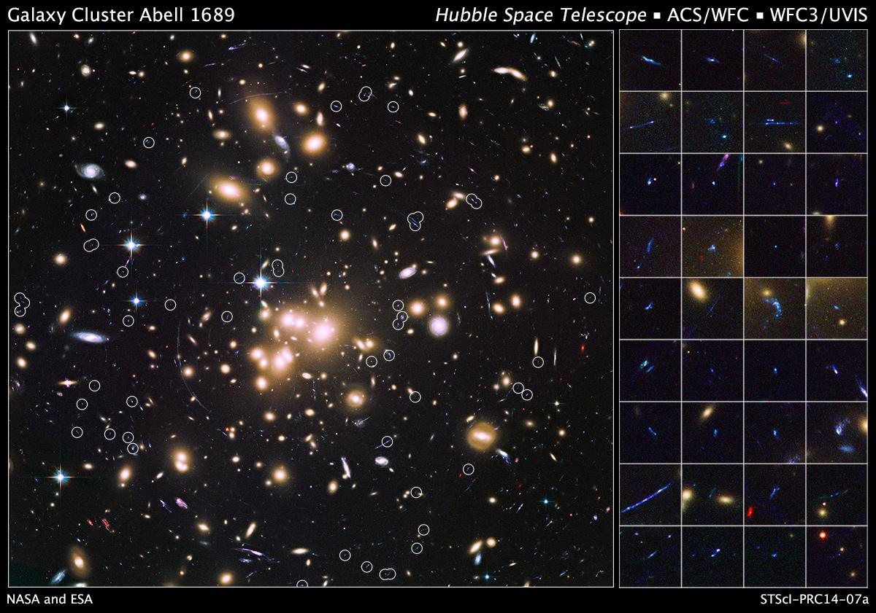
Data variety explodes
Text (indexed Web pages, email), networks (Web graph, knowledge graph), images, maps, logs (search logs, server logs, GPS logs), speech, …

Slide 41
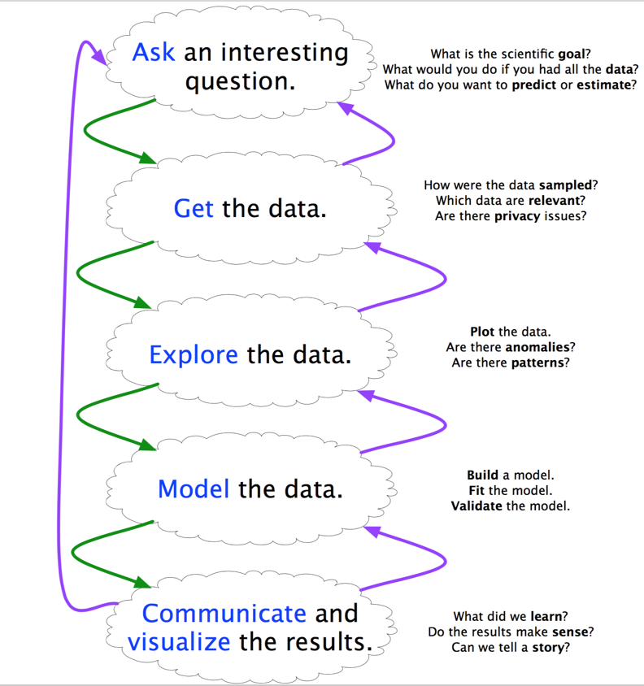
Needed: A method to the madness
Scientific method 1.0: - Focused on “Model the data” - Scientist has hypothesis prior to analyzing the data
Scientific method 2.0:
- Data-driven science - Systematic cycle (see diagram) - “Explore the data” becomes increasingly important
Data as a first-class citizen

Slide 42
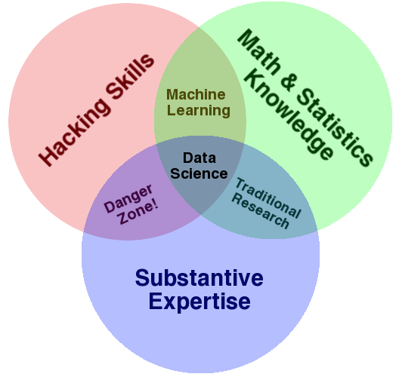
Scientist 2.0

Slide 43
“A data scientist is someone who can obtain, scrub, explore, model, and interpret data, blending hacking, statistics, and machine learning. Data scientists not only are adept at working with data, but appreciate data itself as a first-class product.”
Hilary Mason, chief scientist at bit.ly

Slide 44
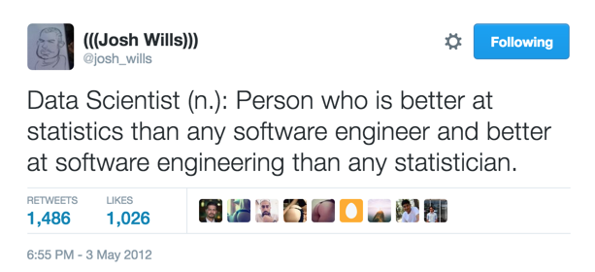
Josh Wills, Data Scientist at Slack

Slide 45
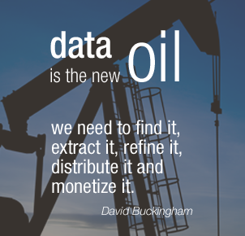

Slide 46
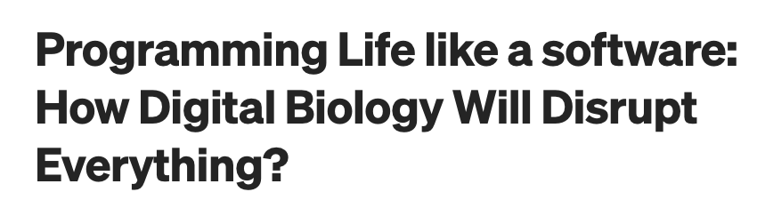
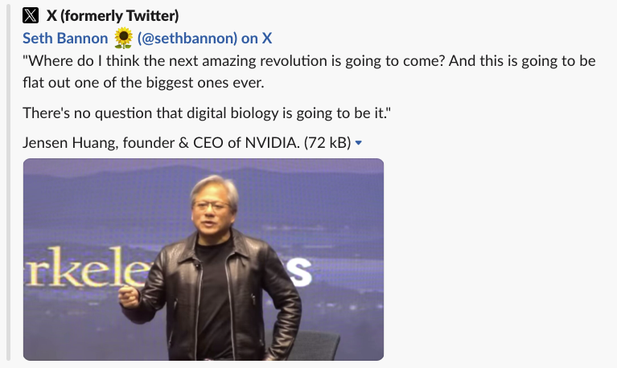

Slide 47
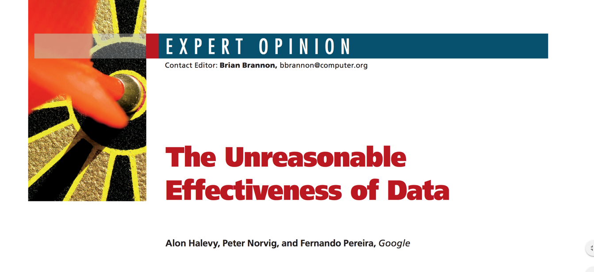
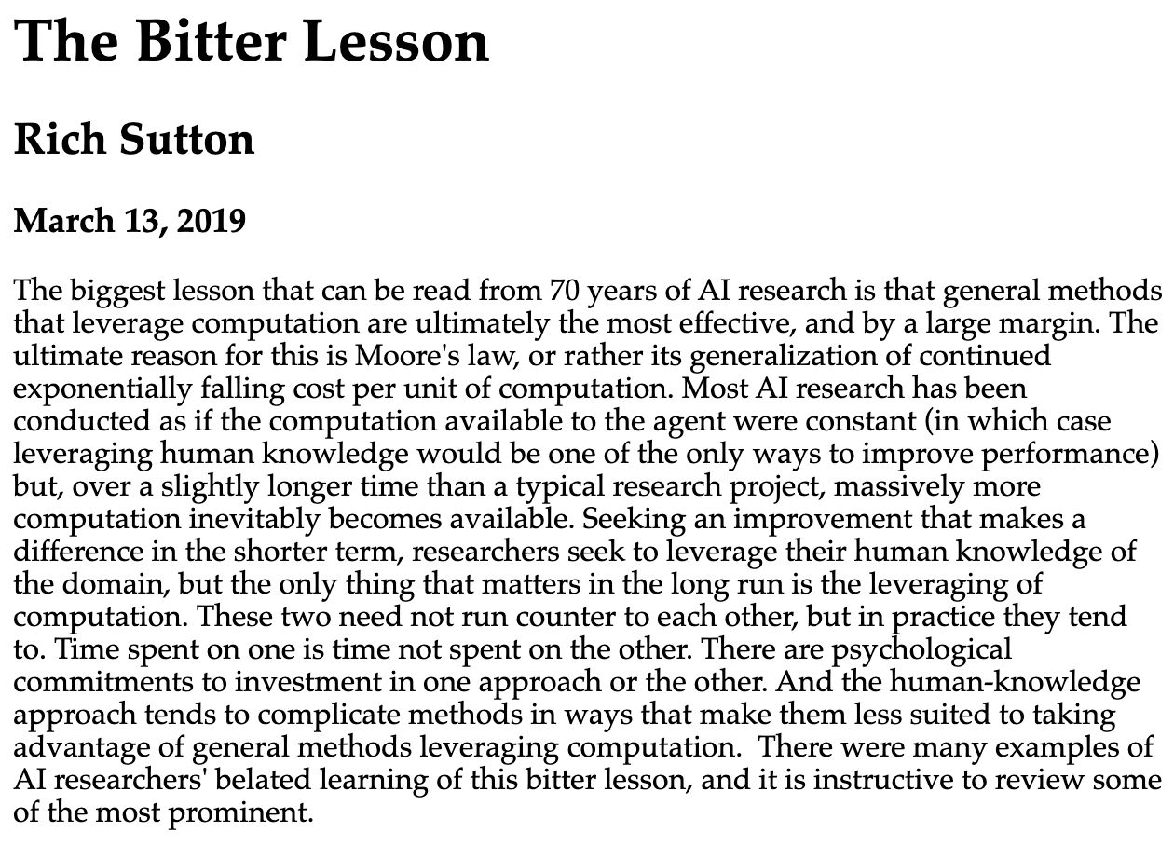
More data often beats better algorithms
http://www.incompleteideas.net/IncIdeas/BitterLesson.html

Slide 48


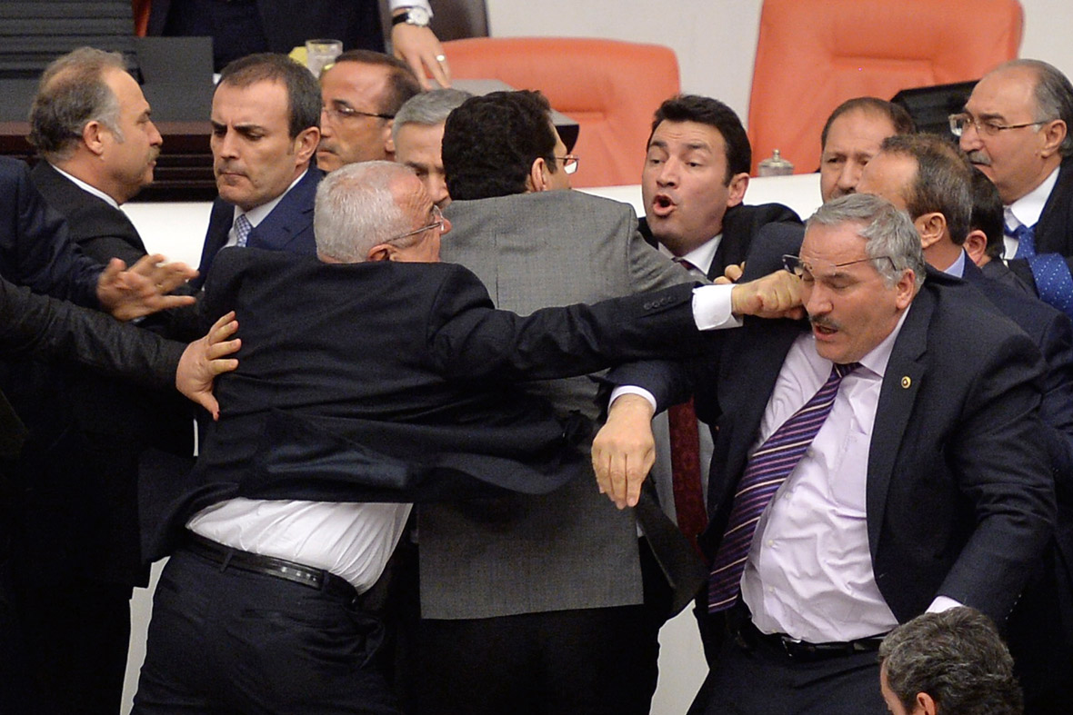
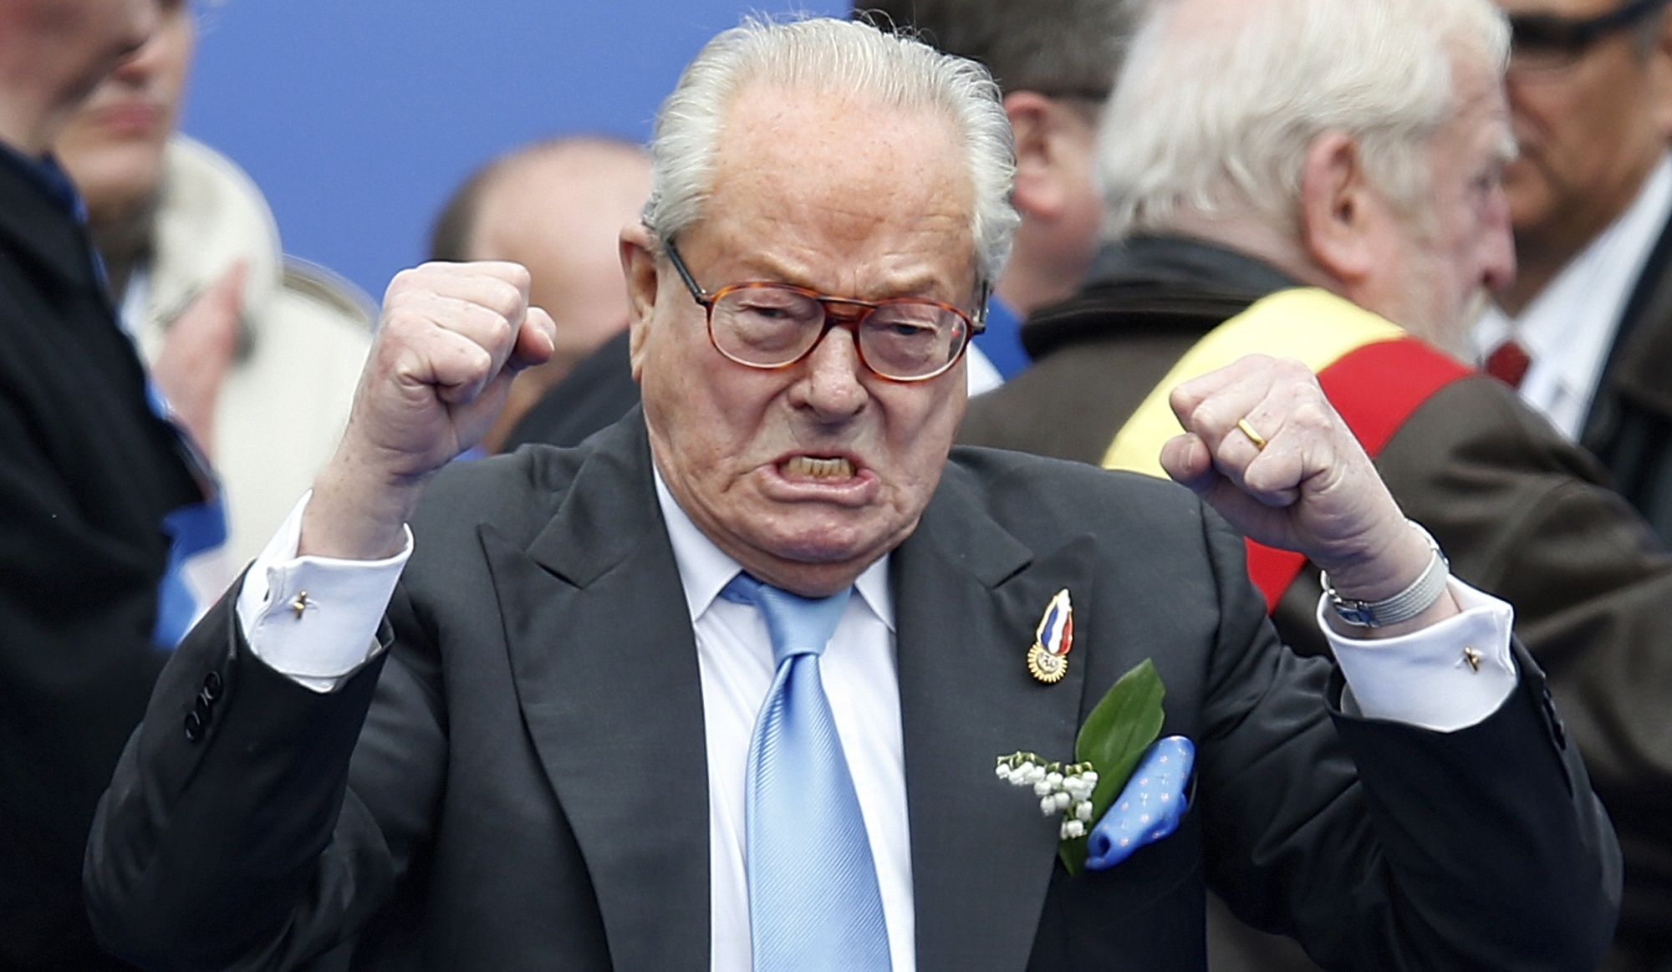
21st-century politics

Slide 49
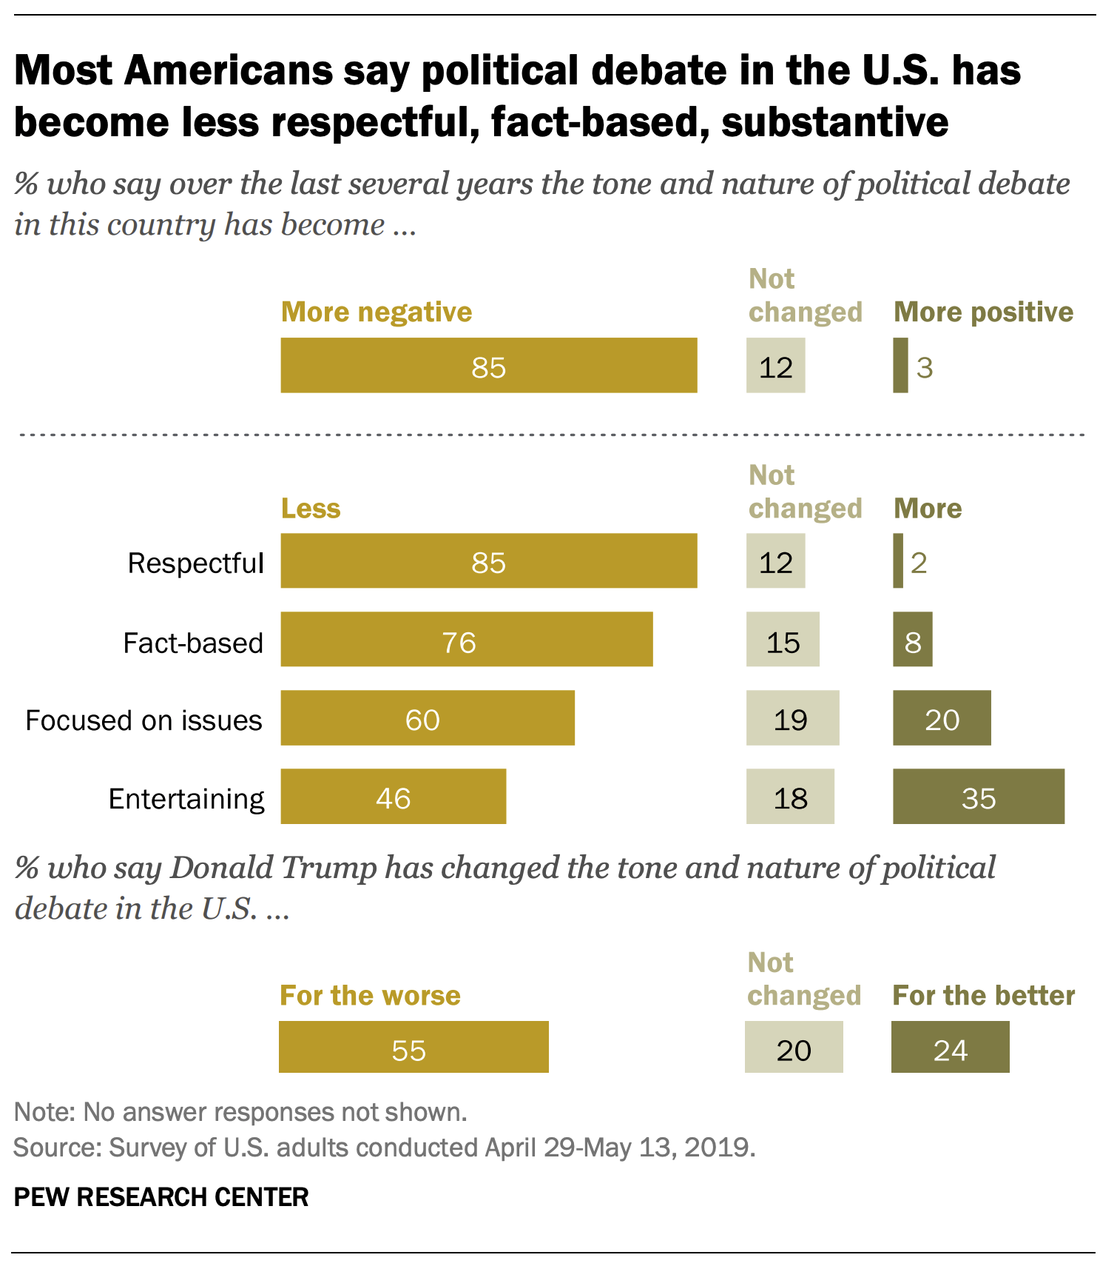
We ask: Do these subjective impressions reflect the true state of US political discourse?
ADA will teach you the tools to answer such questions using data (see next slides)
https://www.pewresearch.org/politics/wp-content/uploads/sites/4/2019/06/PP_2019.06.19_Political-Discourse_FINAL.pdf

Slide 50

Syllabus, revisited
Handling data
Visualizing data
Describing data
Regression analysis for disentangling data
Causal analysis of observational data
Learning from data
Handling text data
Handling network data
Scaling to massive data
Data: https://github.com/epfl-dlab/Quotebank
Web interface: https://quotebank.dlab.tools/

Slide 51
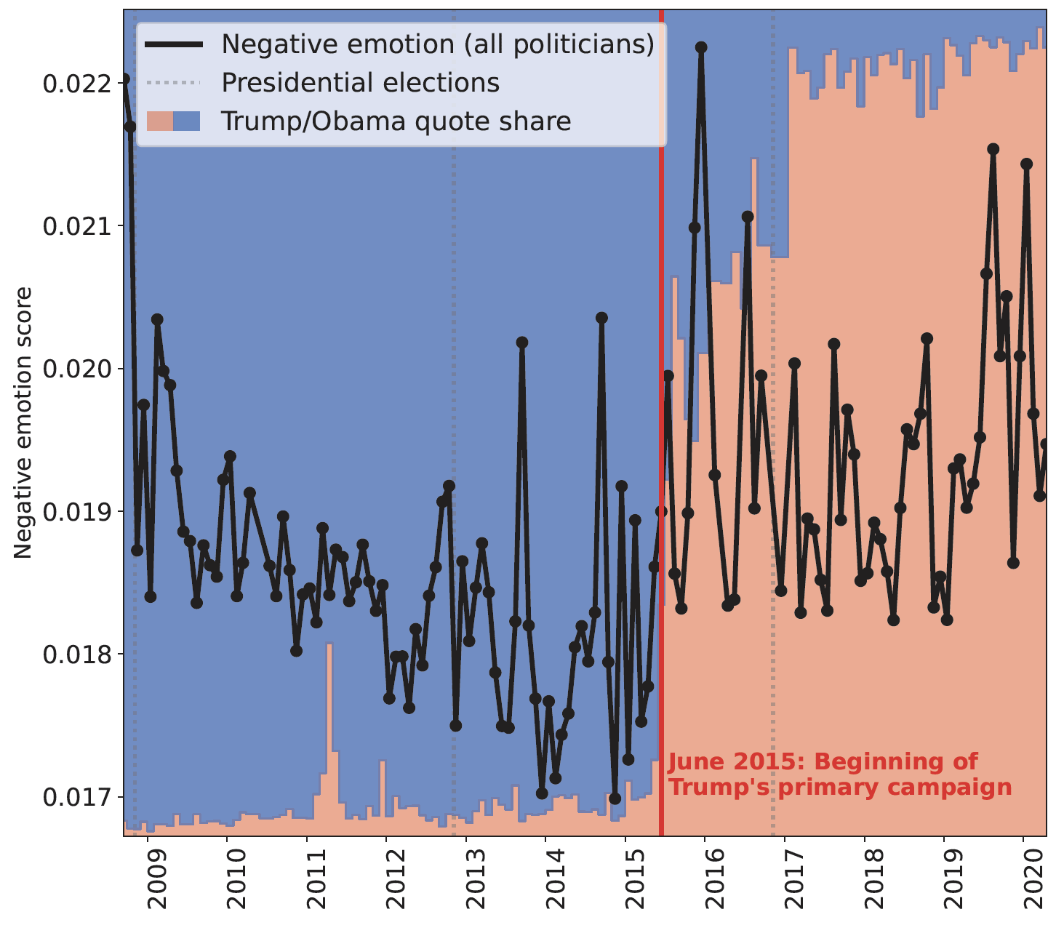
Syllabus, revisited
Handling data
Visualizing data
Describing data
Regression analysis for disentangling data
Causal analysis of observational data
Learning from data
Handling text data
Handling network data
Scaling to massive data

Slide 52
Syllabus, revisited
“Is the effect real, or could it have been produced by chance?”
Handling data
Visualizing data
Describing data
Regression analysis for disentangling data
Causal analysis of observational data
Learning from data
Handling text data
Handling network data
Scaling to massive data

Slide 53
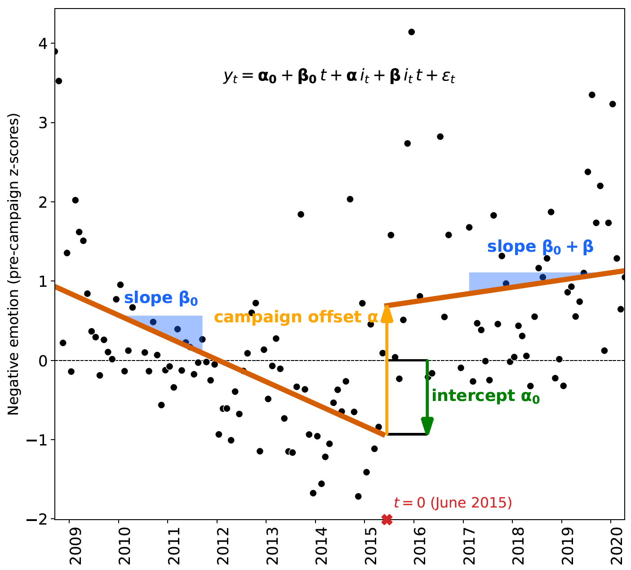
Syllabus, revisited
Handling data
Visualizing data
Describing data
Regression analysis for disentangling data
Causal analysis of observational data
Learning from data
Handling text data
Handling network data
Scaling to massive data

Slide 54
Syllabus, revisited
Handling data
Visualizing data
Describing data
Regression analysis for disentangling data
Causal analysis of observational data
Learning from data
Handling text data
Handling network data
Scaling to massive data
“What caused the observed increase in negativity?”

Slide 55
Syllabus, revisited
Handling data
Visualizing data
Describing data
Regression analysis for disentangling data
Causal analysis of observational data
Learning from data
Handling text data
Handling network data
Scaling to massive data
Quotes were attributed to speakers by a machine learning algorithm

Slide 56
Syllabus, revisited
Handling data
Visualizing data
Describing data
Regression analysis for disentangling data
Causal analysis of observational data
Learning from data
Handling text data
Handling network data
Scaling to massive data
Research question (“Did political discourse become more negative?”) is a question about language == text

Slide 57
Syllabus, revisited
Handling data
Visualizing data
Describing data
Regression analysis for disentangling data
Causal analysis of observational data
Learning from data
Handling text data
Handling network data
Scaling to massive data
“Who speaks about whom in what way?” → Construct “who-mentions-whom” network

Slide 58
Syllabus, revisited
Handling data
Visualizing data
Describing data
Regression analysis for disentangling data
Causal analysis of observational data
Learning from data
Handling text data
Handling network data
Scaling to massive data
Extracting 235 million quotes from 127 million news articles (about 1 terabyte of raw text) spanning 12 years requires big-data tools (e.g., Spark)

Slide 59
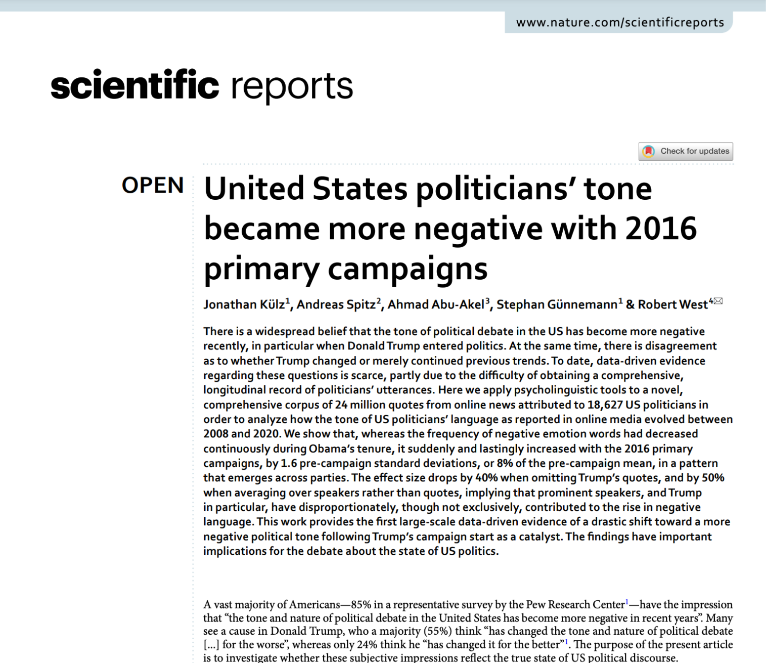
Curious to learn more?
Full paper available at https://www.nature.com/articles/s41598-023-36839-1

Slide 60
TODO before Friday’s lab session
Sign up for Ed here and familiarize yourself with it
If you’re not on GitHub yet, sign up for GitHub
Start looking for 4 teammates
You may use “Group formation” category on Ed
Check out Google Colab and noto (to see if you want to use either of them)
Check out Exercise 0 here (in prep for Fri lab session)

Slide 61
Any feedback? -- Let us know!
Give us feedback on this lecture here: https://go.epfl.ch/ada2024-lec1-feedback
Feedback form available for each lecture and lab session
What did you (not) like about this lecture?
What was (not) well explained?
On what would you like more details?
What would you like the instructor to wear next time?
…

